Slide 1
Digicard.inc
Group No: 36

Slide 2
About
Company
INDEX
Tools and Technologies
03
01
Website Design
02
Project Introduction
04
Reports
05

Slide 3

Group Members:
Henis D’costa (20-BCA-028)
Asmi Halvadia (20-BCA-040)
Ridham Kalra (20-BCA-057)
Internal Guide : Dr. Dhara Bhatt
External Guide : Mr. Atul Jose

Slide 4

About Company

Slide 5
Prince Management
Prince Management provides one stop automated solution for your financial requirements. Depending on the Client need and Corporate, we have different products and services to meet your requirements. We provide the optimum and customized solutions made for you.
Prince Management began its business operation as a Channel Partner of ICICI Bank Ltd. for Credit Cards in Ahmedabad in October2014.
Prince Management is focusing exclusively on Credit Card sourcing in Gujarat. We are advancing on a tremendous pace and with involvement of skilled and experienced people working in the organization. PRINCE MANAGEMENT is currently doing business in Government, MNCs, Large Corporate, Telecom and Retail Sector.

Slide 6
Prince Management
Services: Channel Partners For Credit Card Of ICICI Bank, IndusInd Bank, AU Small Finance Bank, SBI Bank, Yes Bank, Standard Charted Bank
Address: FIRST FLOOR, BHAVANI CHAMBERS, OPP BAIT INN HOTEL, NR BATA CROSS ROAD, ASHRAM ROAD, AHMEDABAD: 380009
Email Id: princemgmt1609@gmail.com
Mobile Num: +91 9825506872

Slide 7

Project Introduction

Slide 8
About Digicard.inc
Digicard.inc aims to provide a platform where people can apply for credit cards & loans from different banks at one platform .
Directly from our website , people can apply for the process without going to the banks personally .
Users can login to the website , evenly they can track the status of his/her application.
This website will mainly help people to not visit the banks physically & get the details of various credit cards ,offers related to it.

Slide 9

Tools And Technologies

Slide 10







Tools And Technologies Used
Front-End Technology
Back-End Technology
PHP Myadmin PHP8.1 Report Maker 9
Tools
Presentation: Microsoft PowerPoint

Slide 11

Website Design

Slide 12
Home Page
Landing Page when the anyone loads the website.

Slide 13
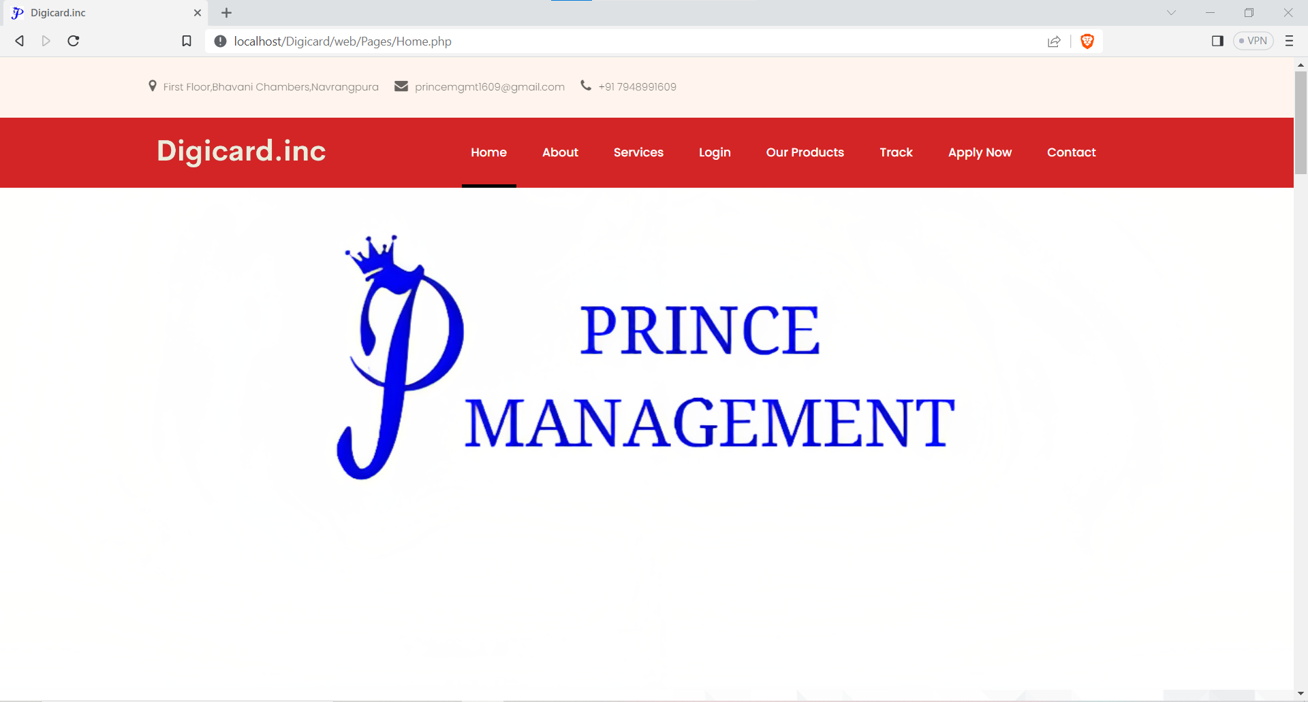

Slide 14
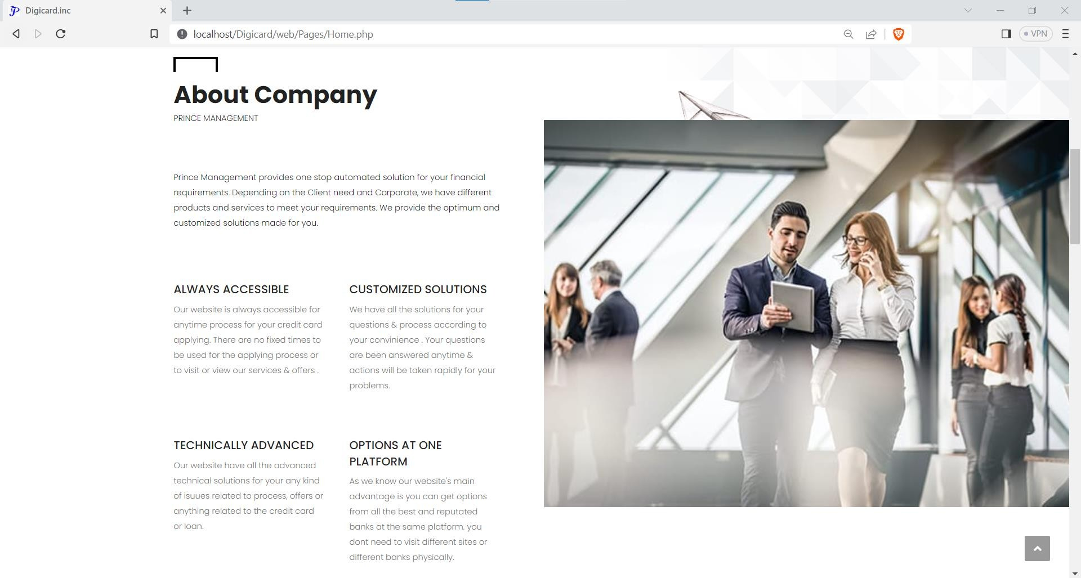

Slide 15
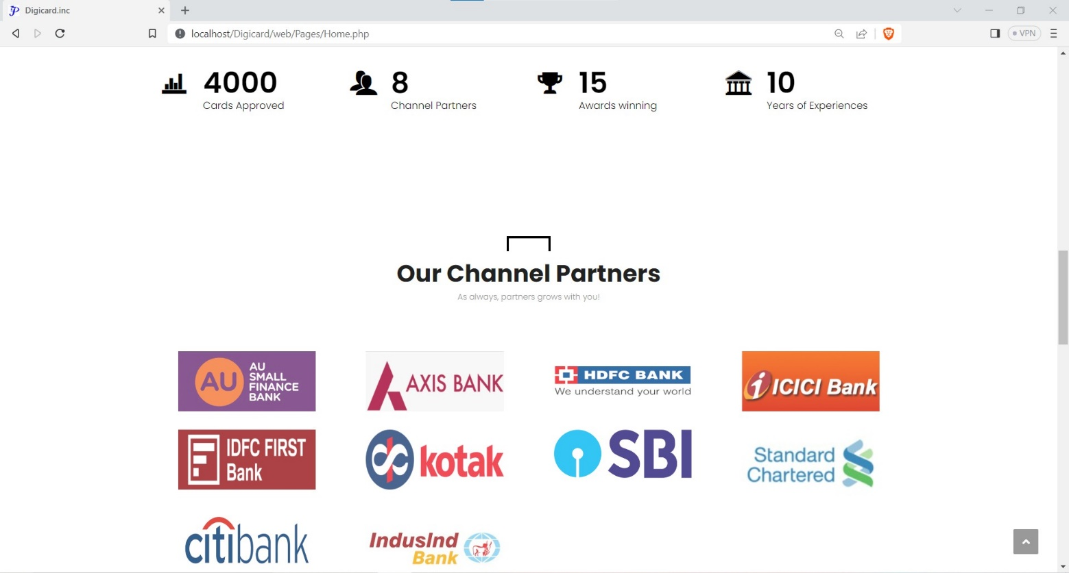

Slide 16
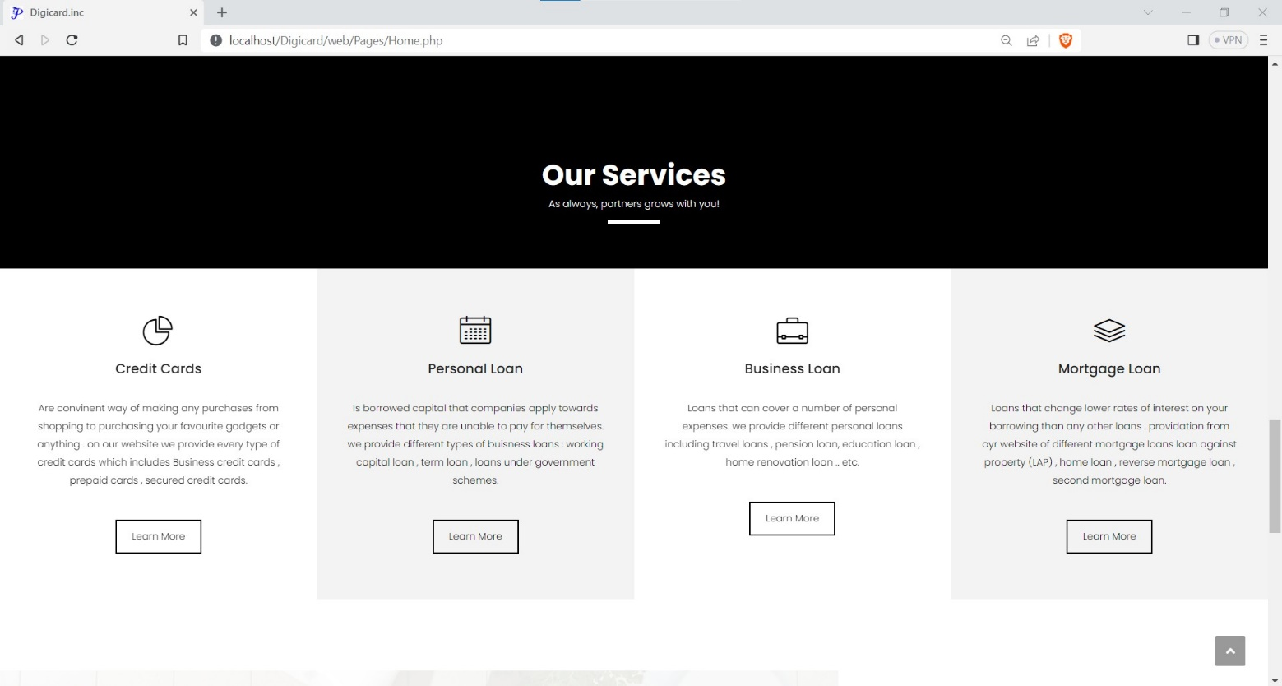

Slide 17
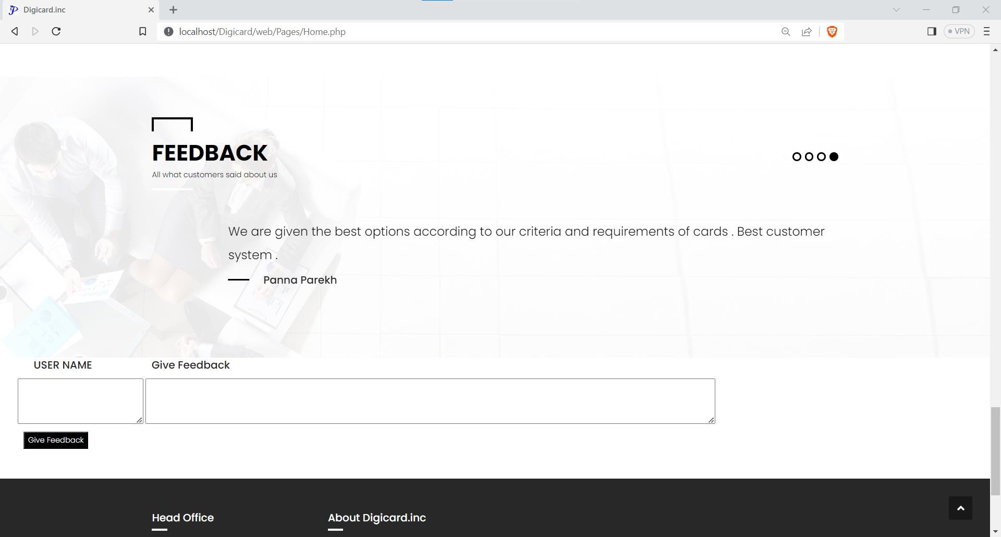

Slide 18
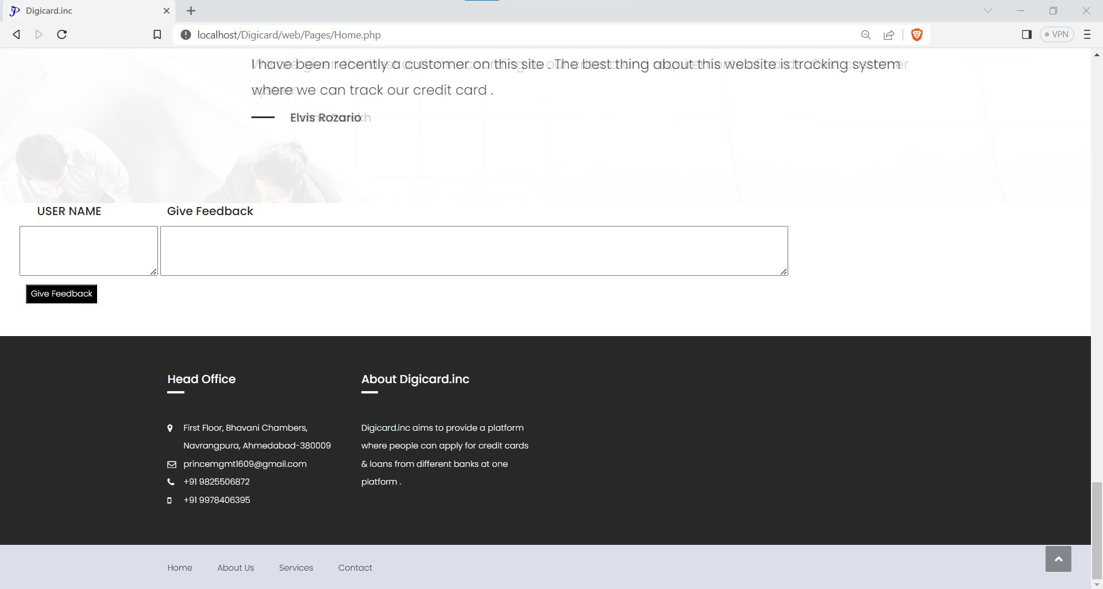
By entering user name and feedback user can submit feedback.

Slide 19
About page contains a brief description about the company..
About Page

Slide 20
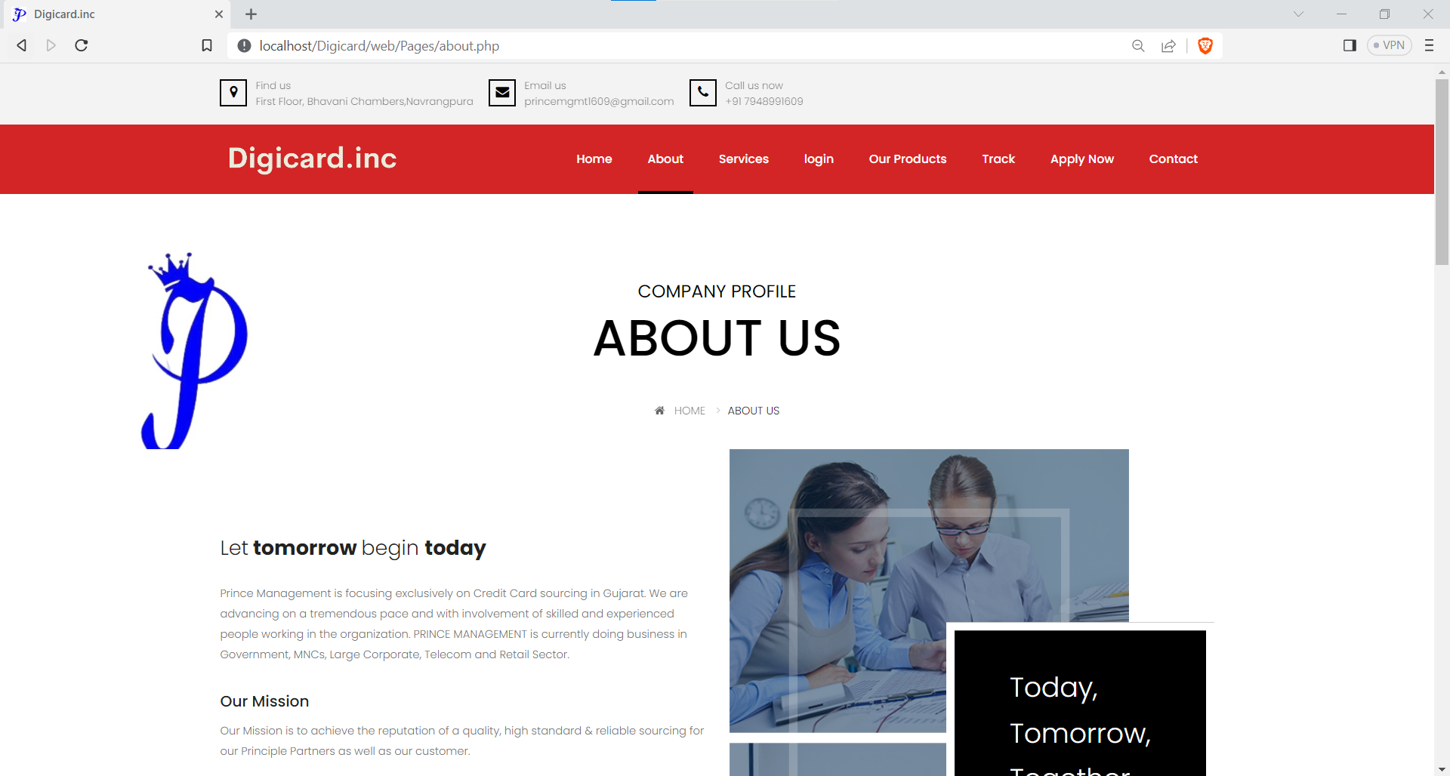

Slide 21
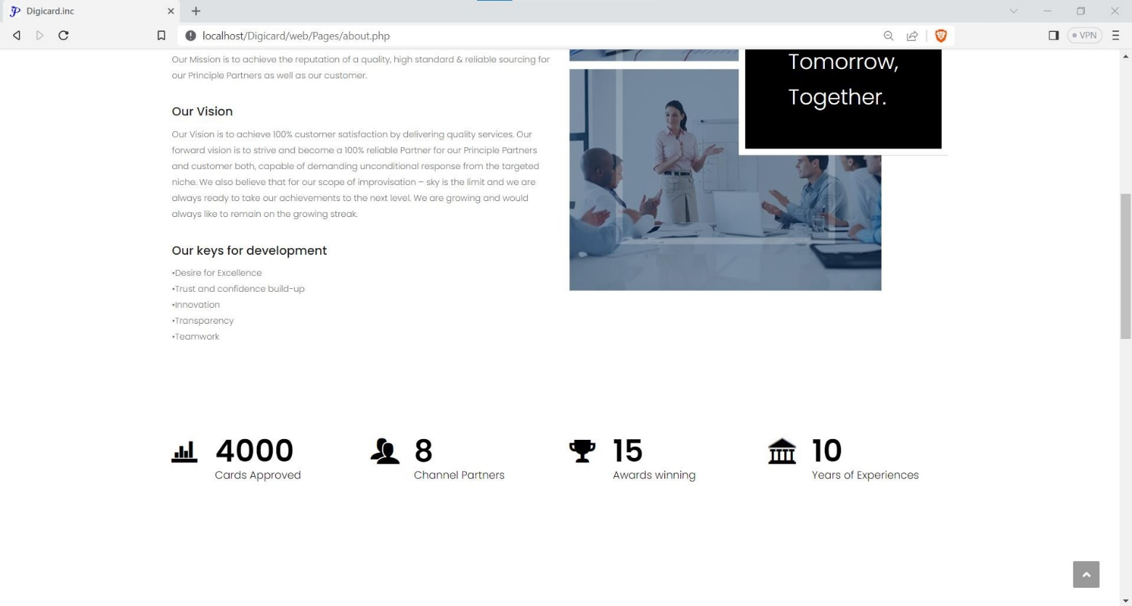

Slide 22
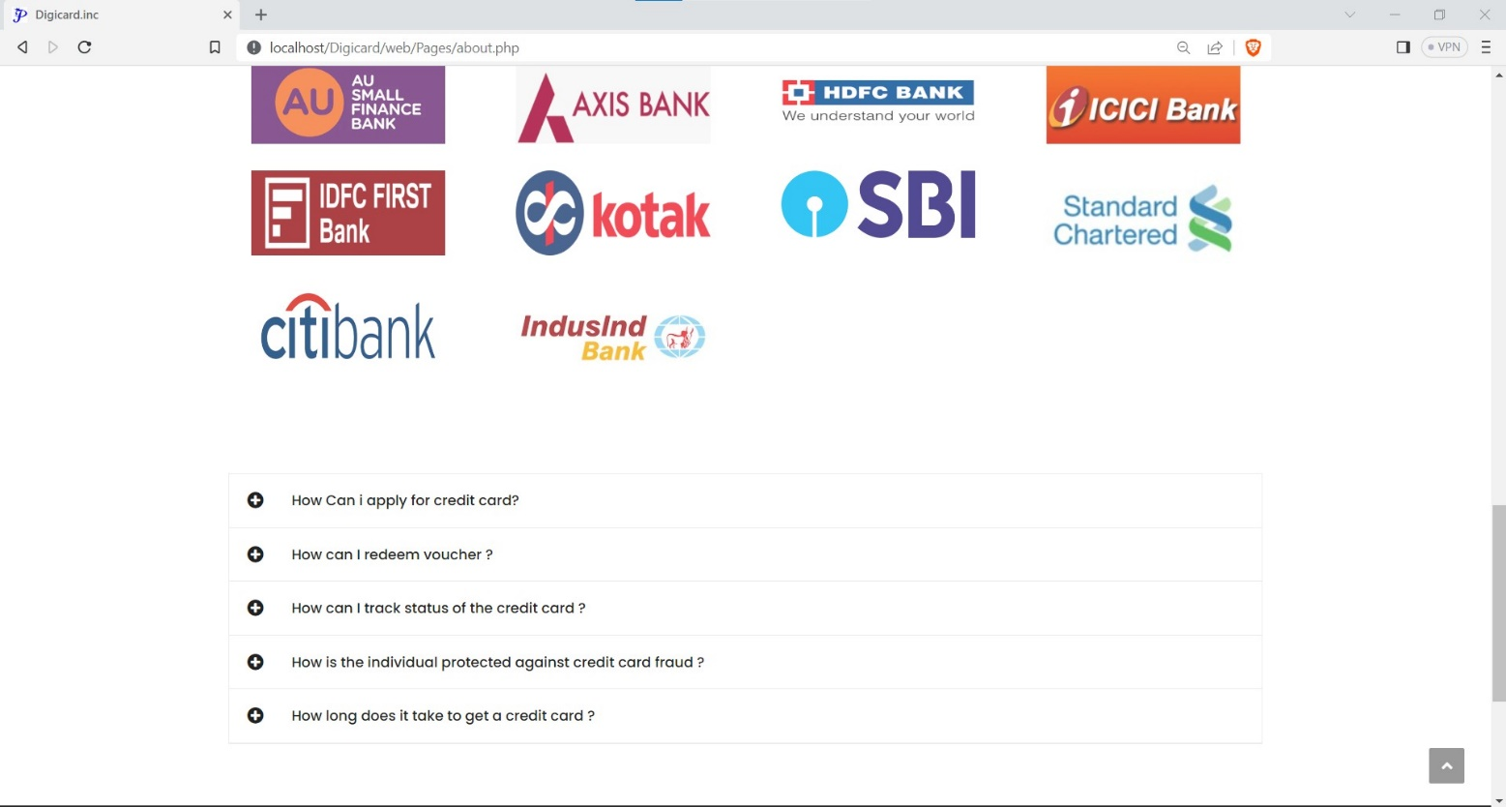
By clicking on the + option user can view the FAQ’s.

Slide 23
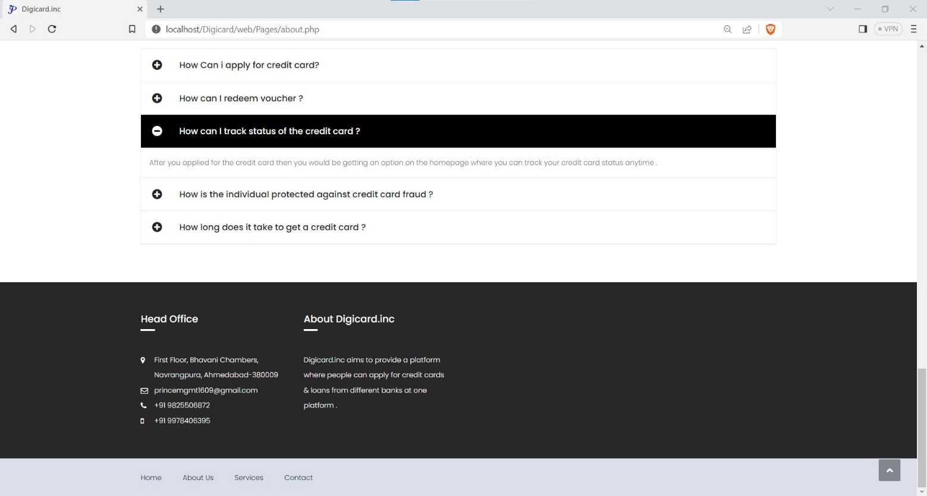

Slide 24
Services Page
Users can find all the services that are provided by the our site on the services page.

Slide 25
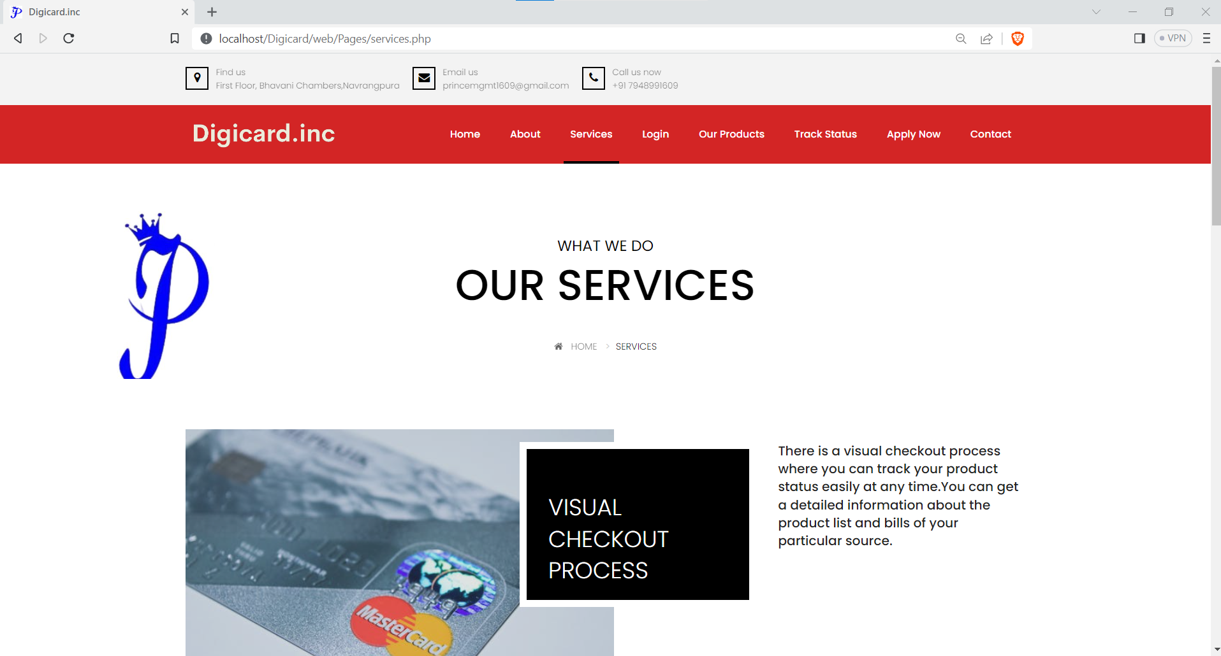

Slide 26
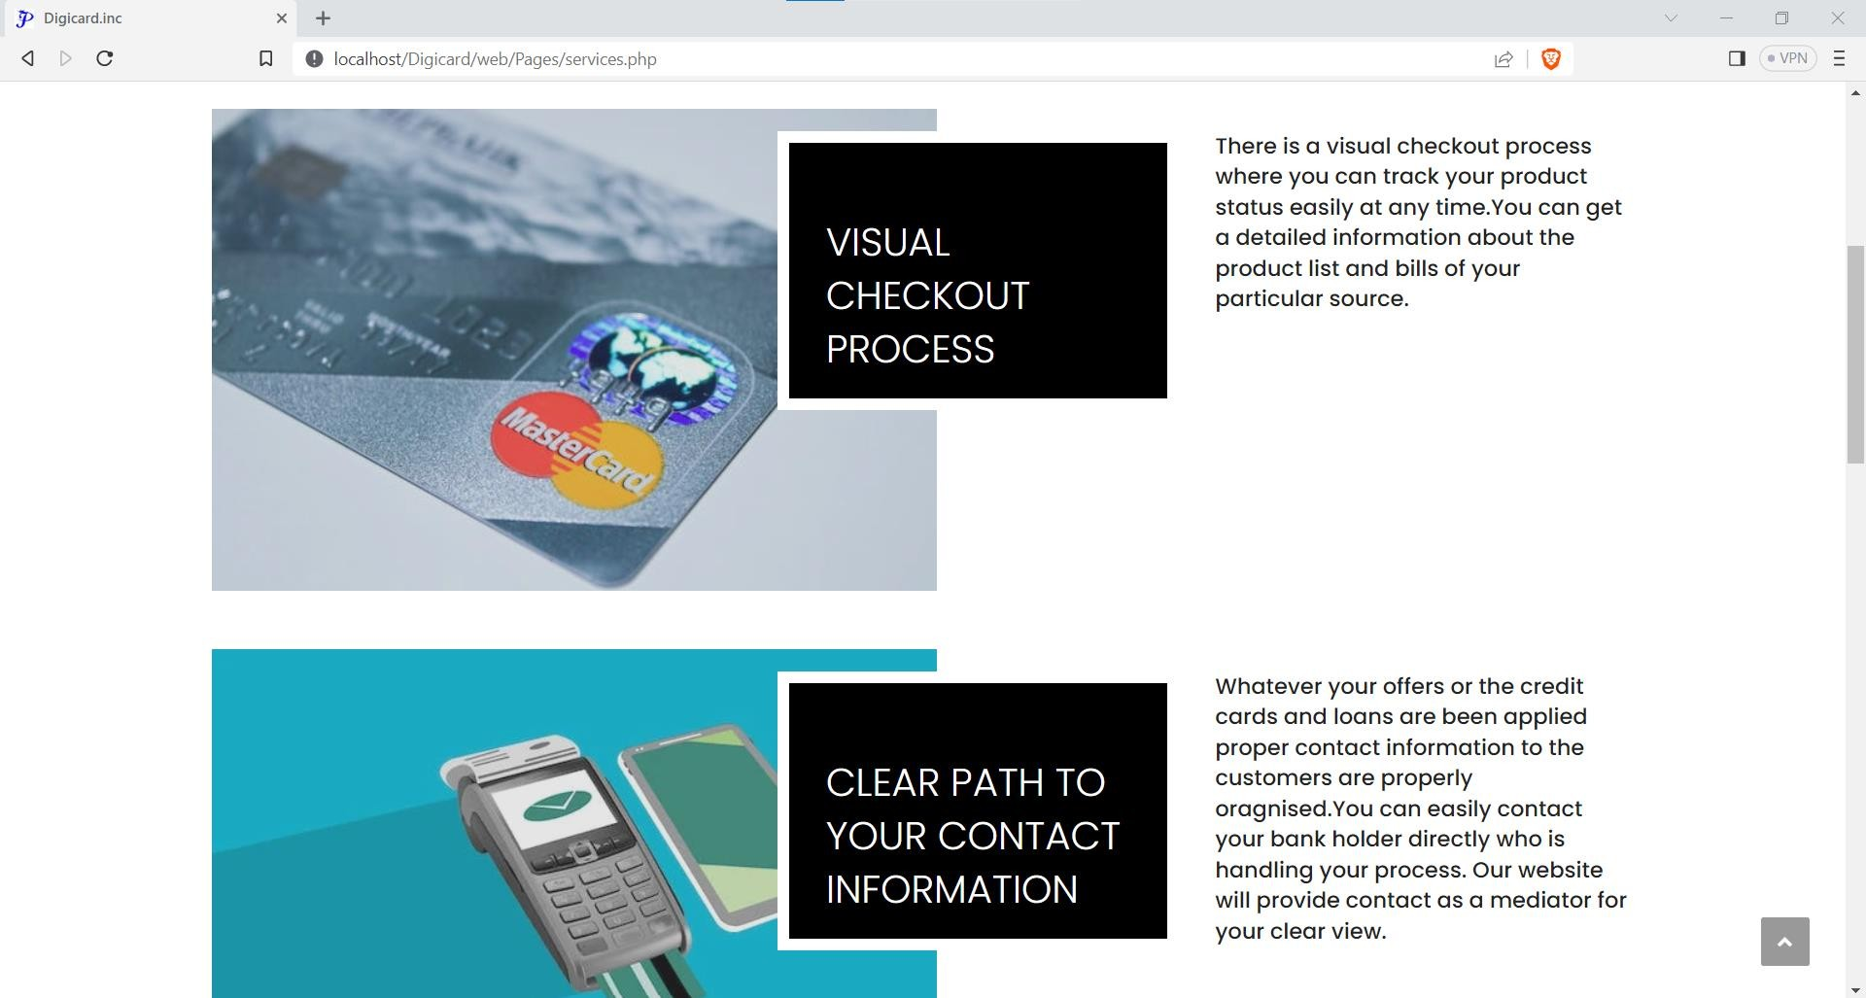

Slide 27
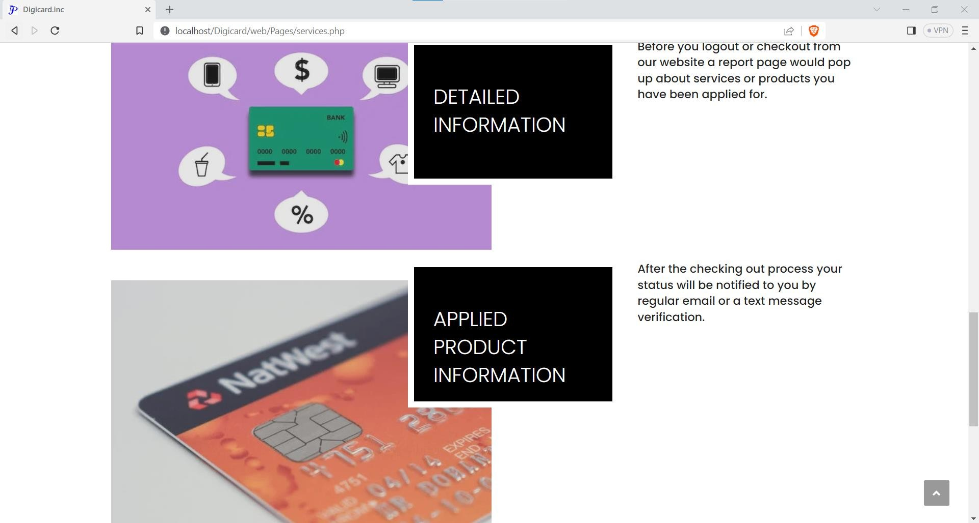

Slide 28
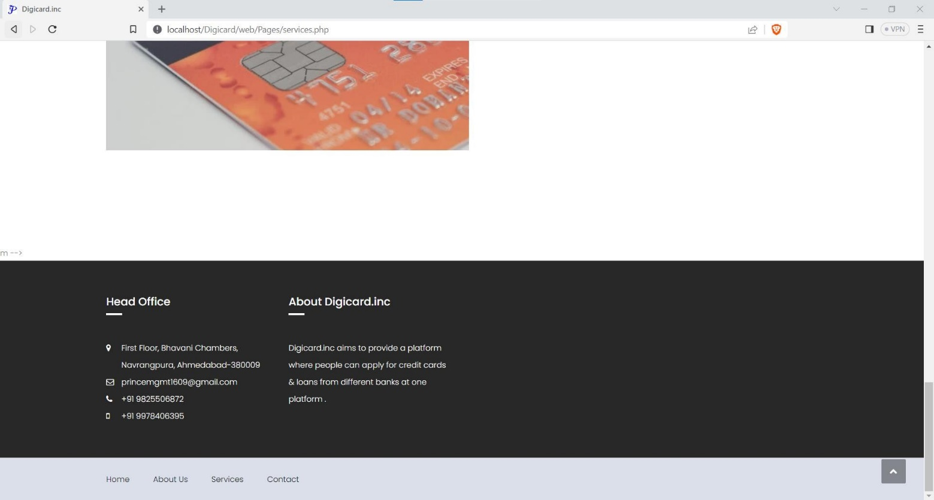

Slide 29
CONTACT
Users can get the contact details of the company by clicking on the contact us page

Slide 30
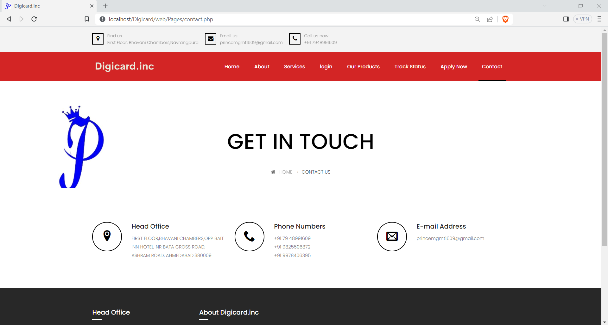

Slide 31
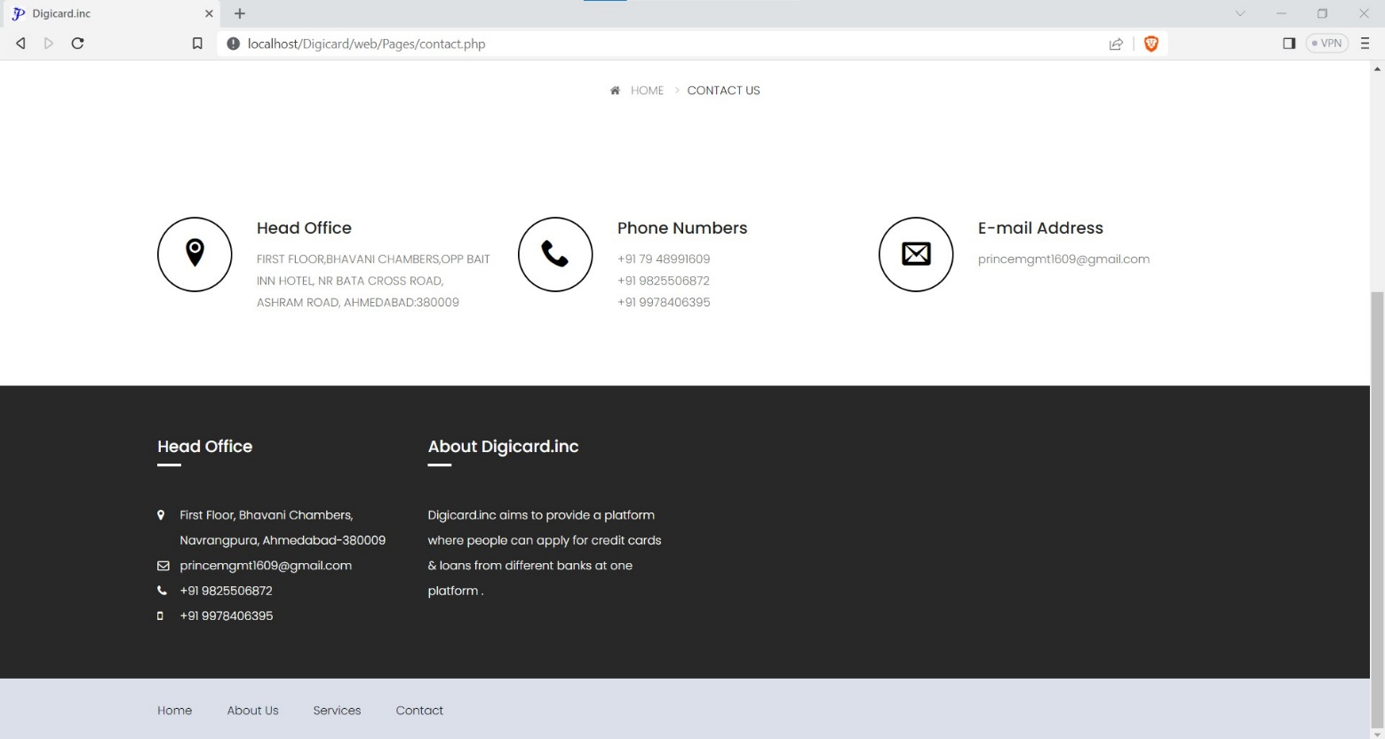

Slide 32
User Signup
User can create his account by clicking on the signup button on the top right corner of the home page.

Slide 33
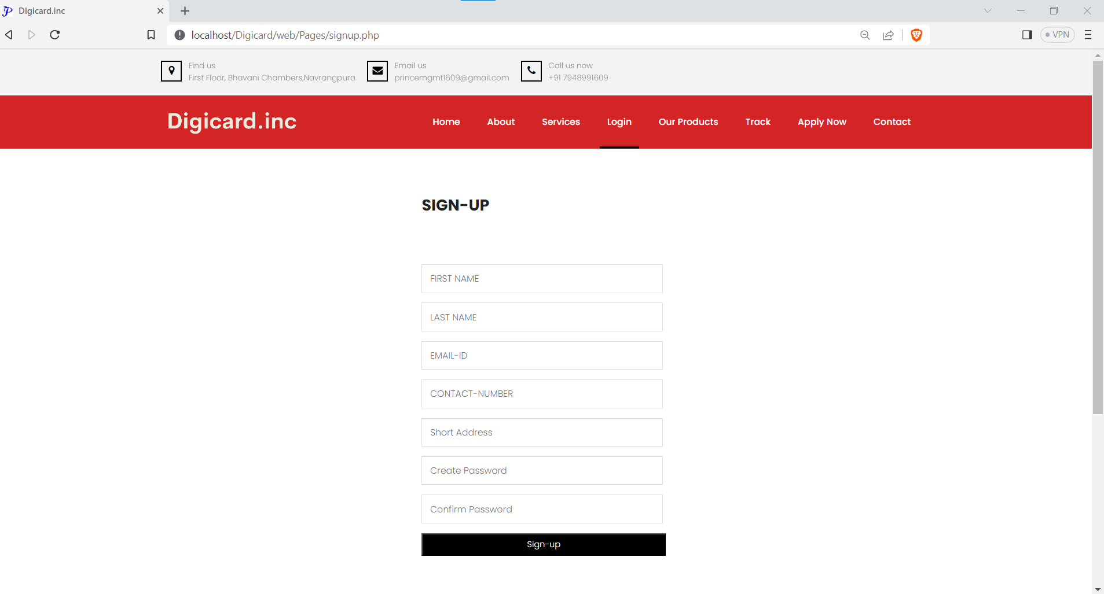

Slide 34
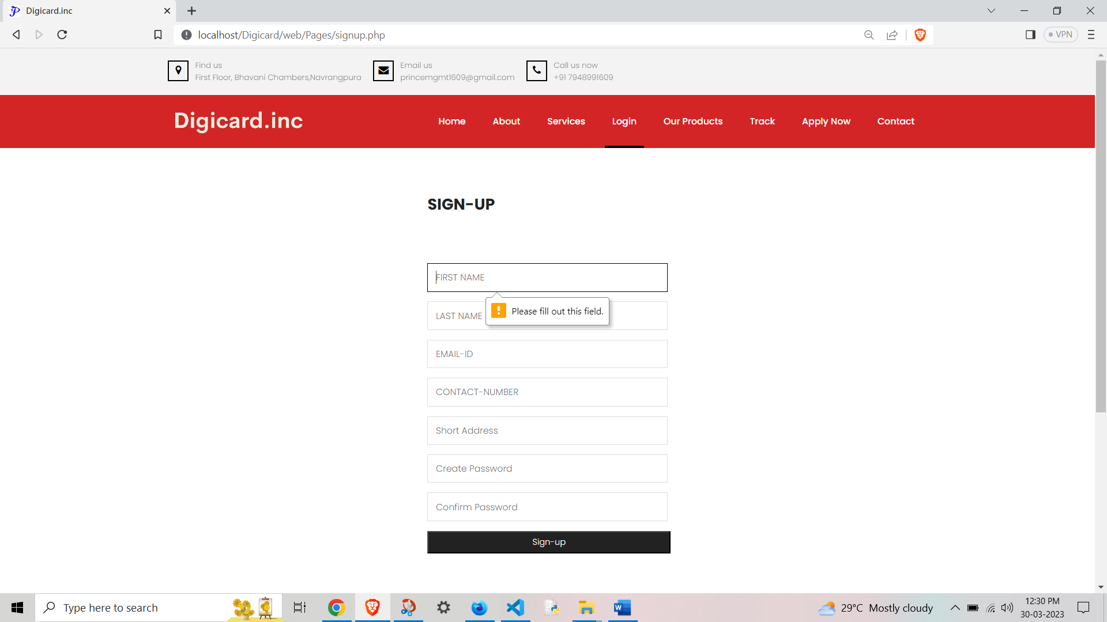

Slide 35
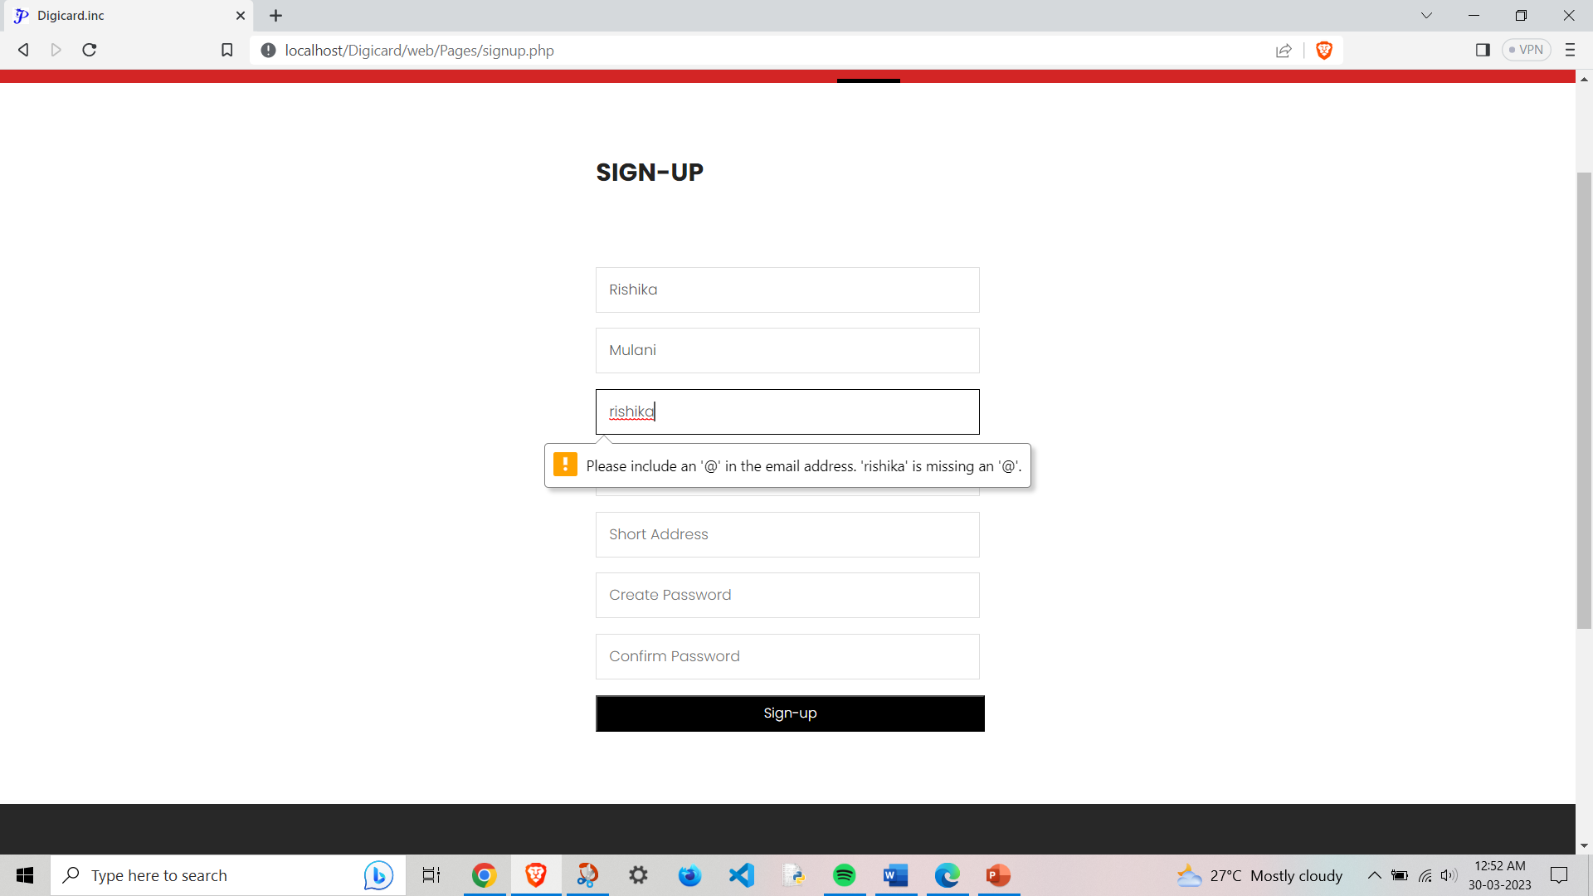

Slide 36
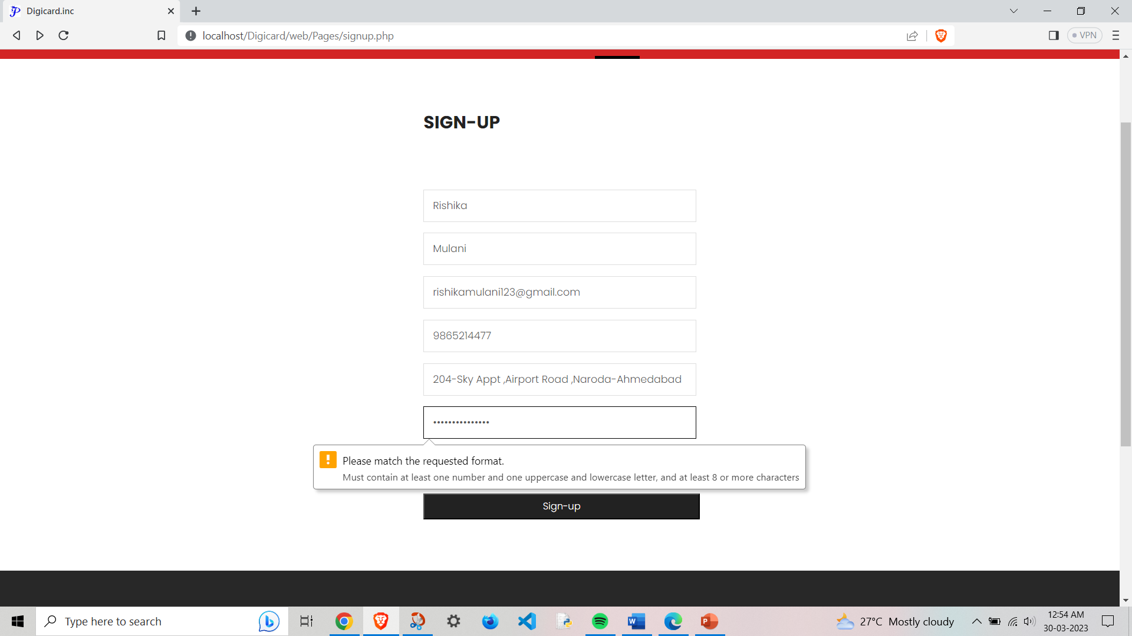

Slide 37
User Login
User can login to his account by clicking on the login button on the top right corner of the home page.

Slide 38
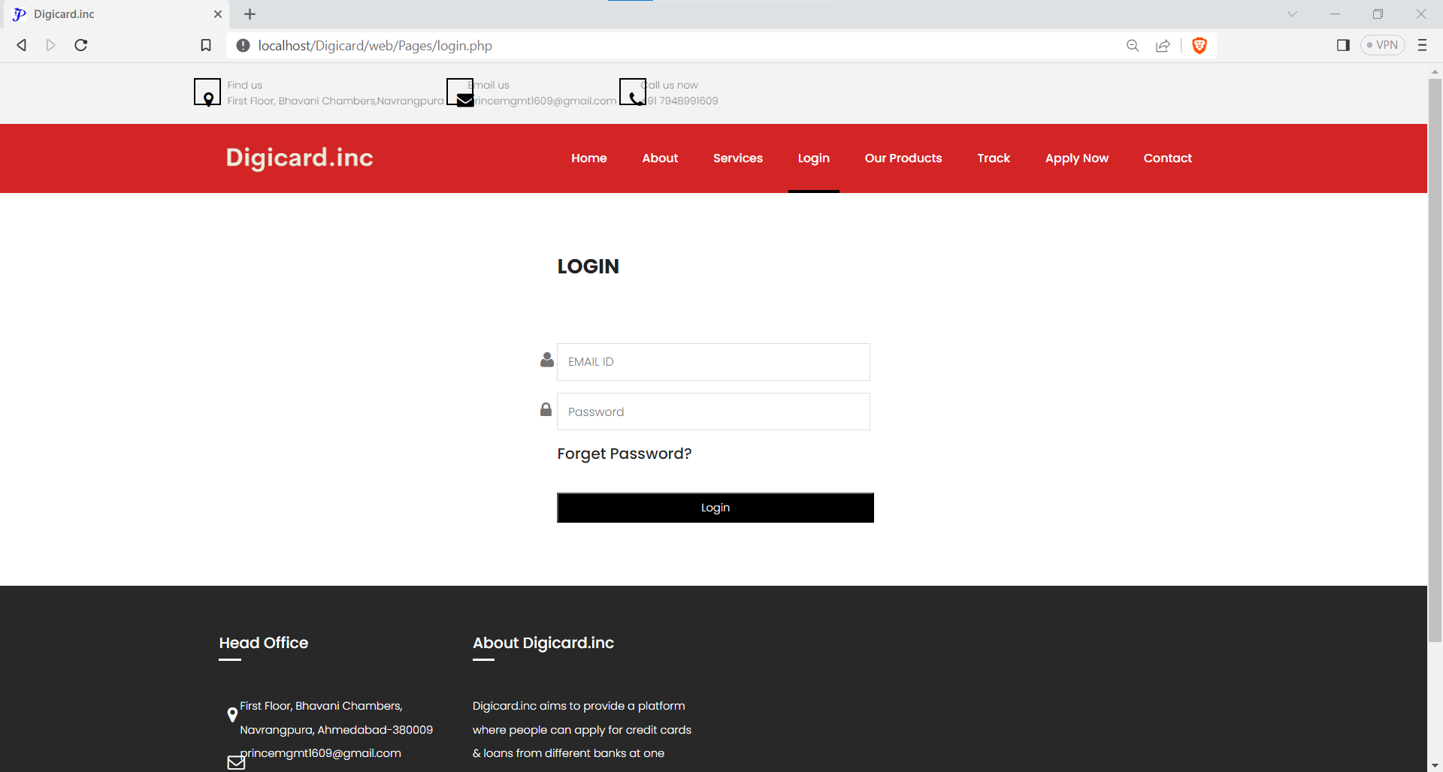

Slide 39
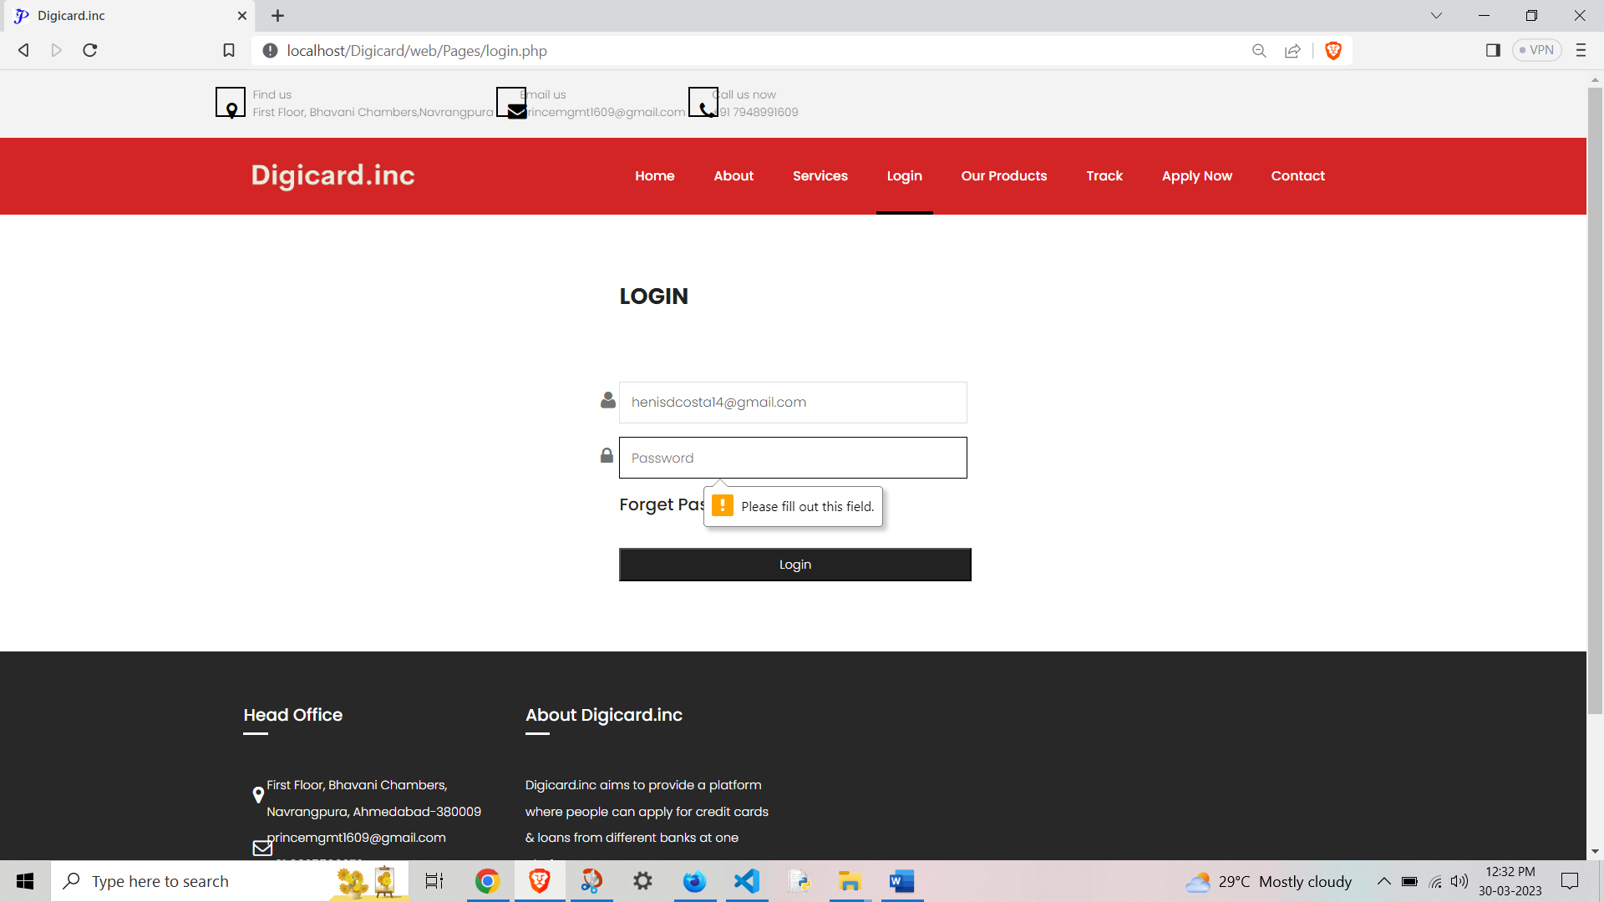

Slide 40
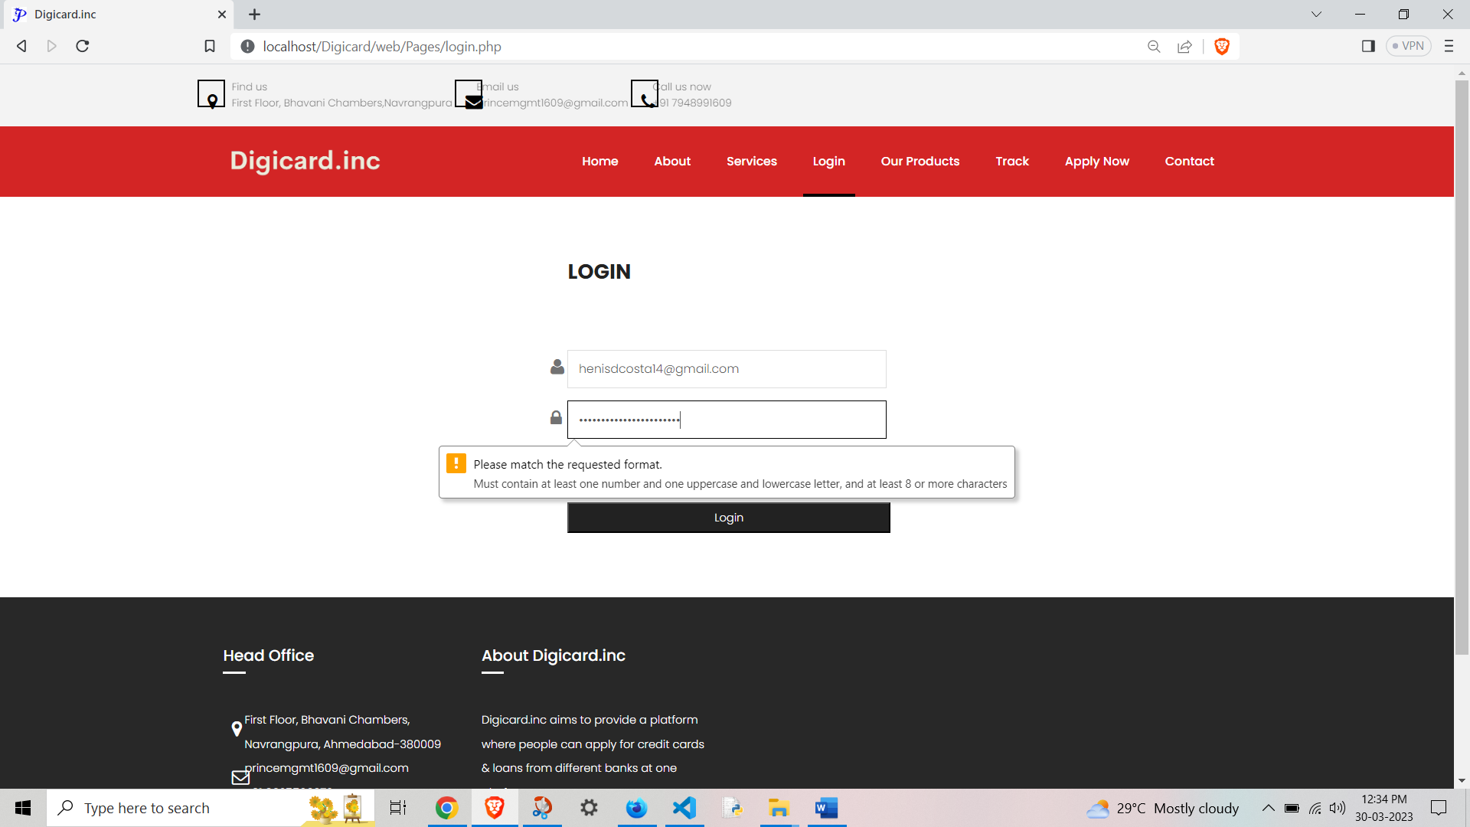

Slide 41
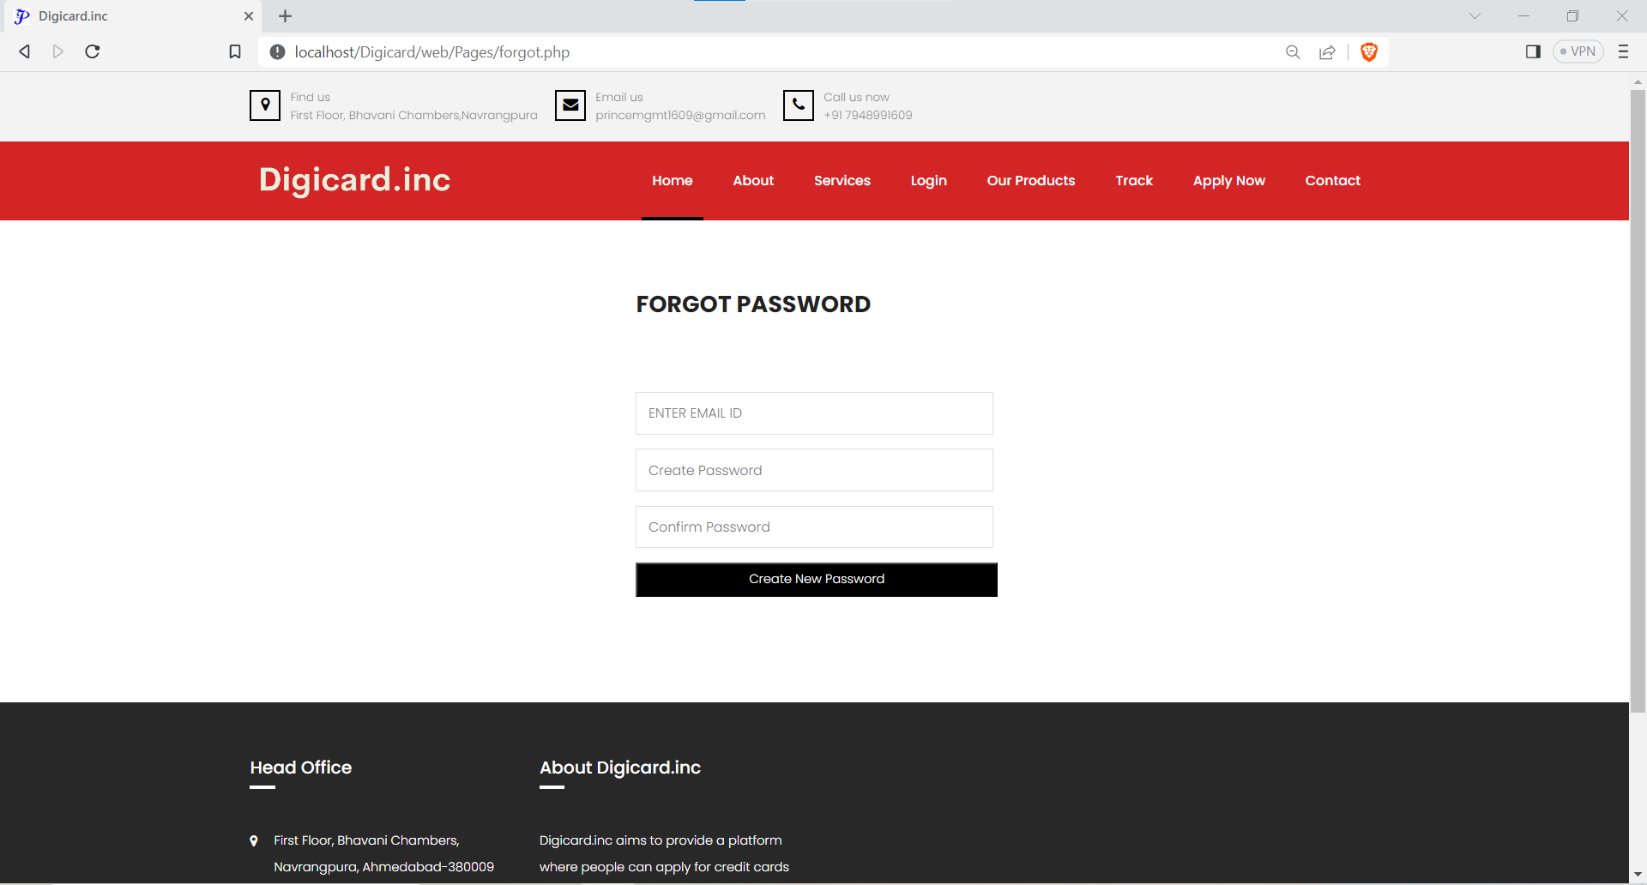

Slide 42
User Menu
User can update profile/view ,reedeem voucher and logout by click on the top right corner of the page.

Slide 43
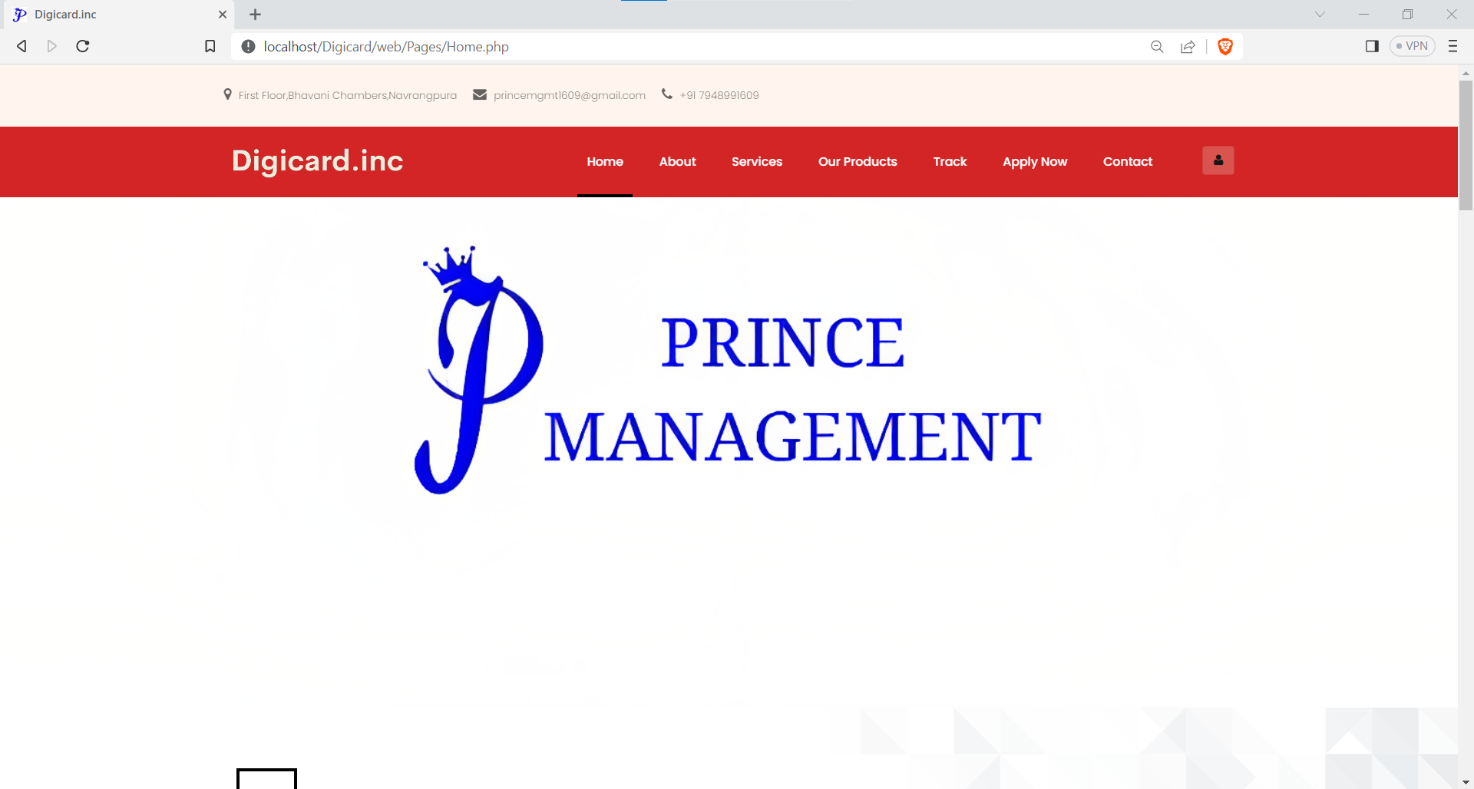
User Menu

Slide 44
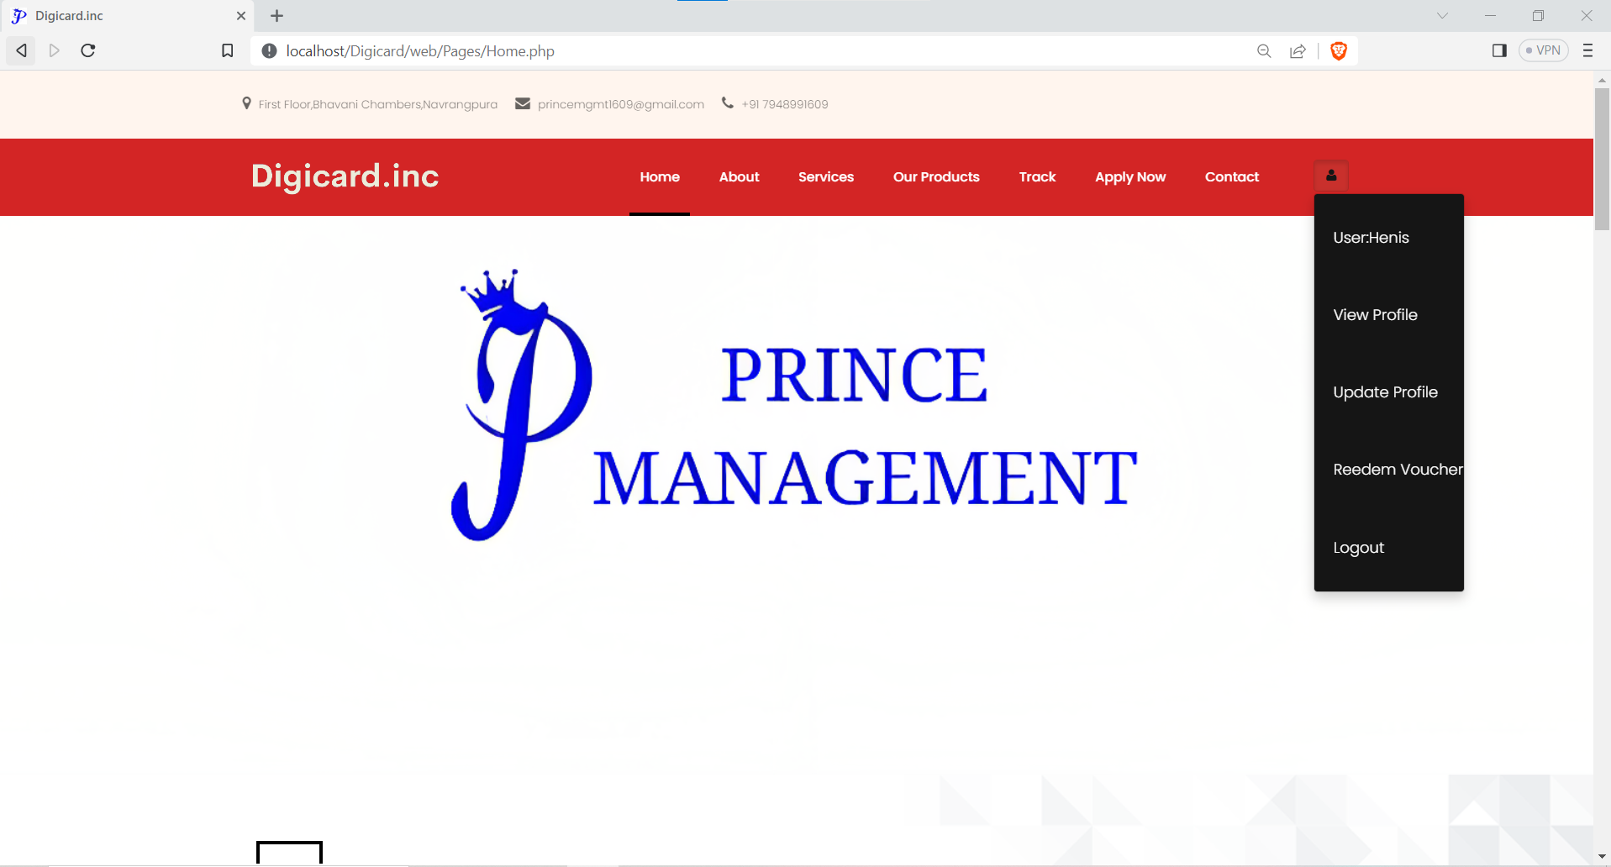

Slide 45
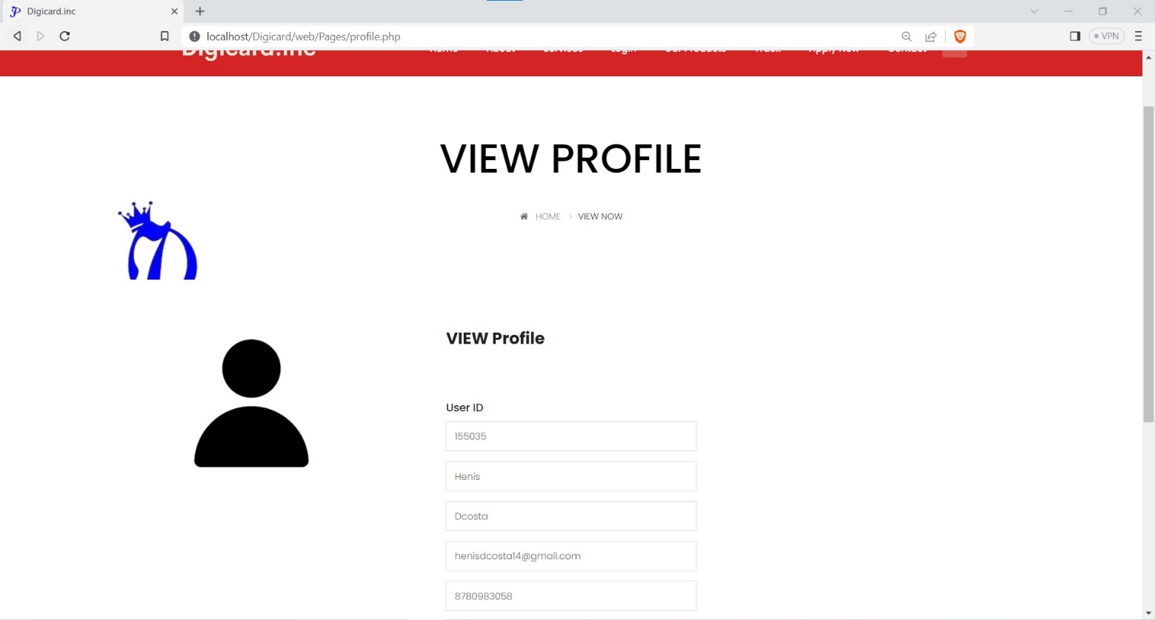

Slide 46
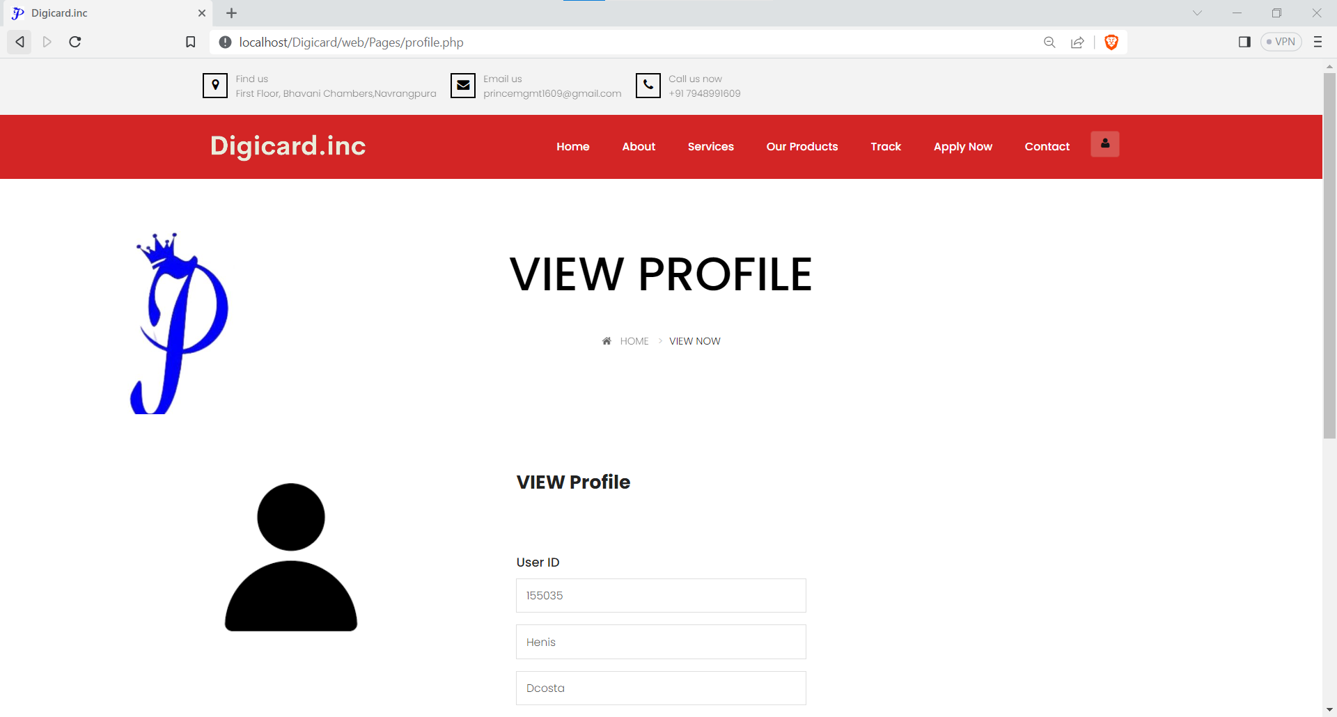

Slide 47
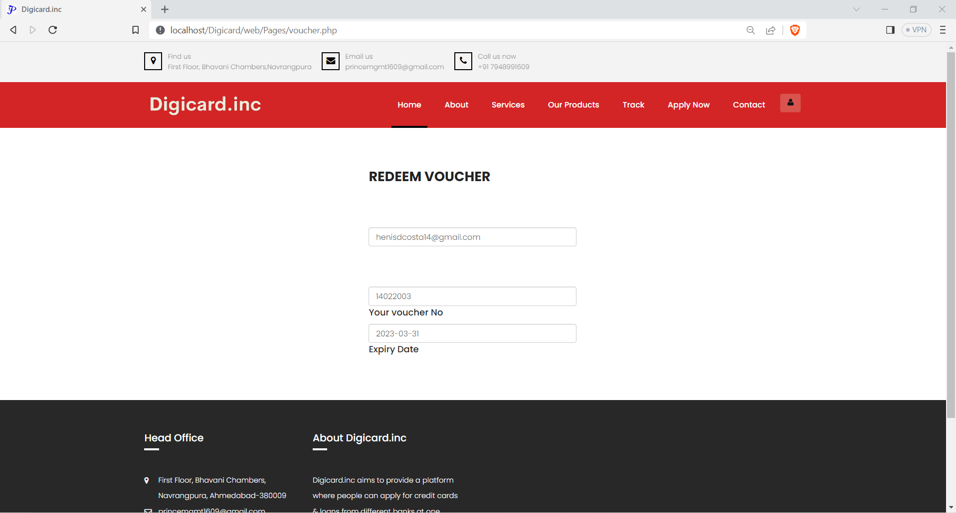

Slide 48
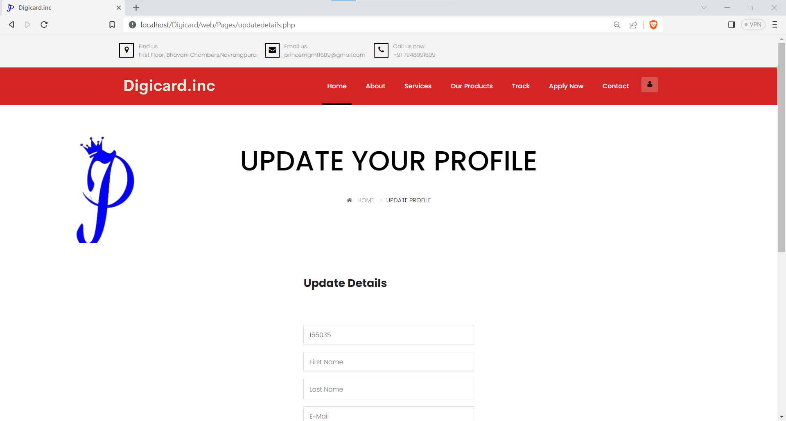

Slide 49
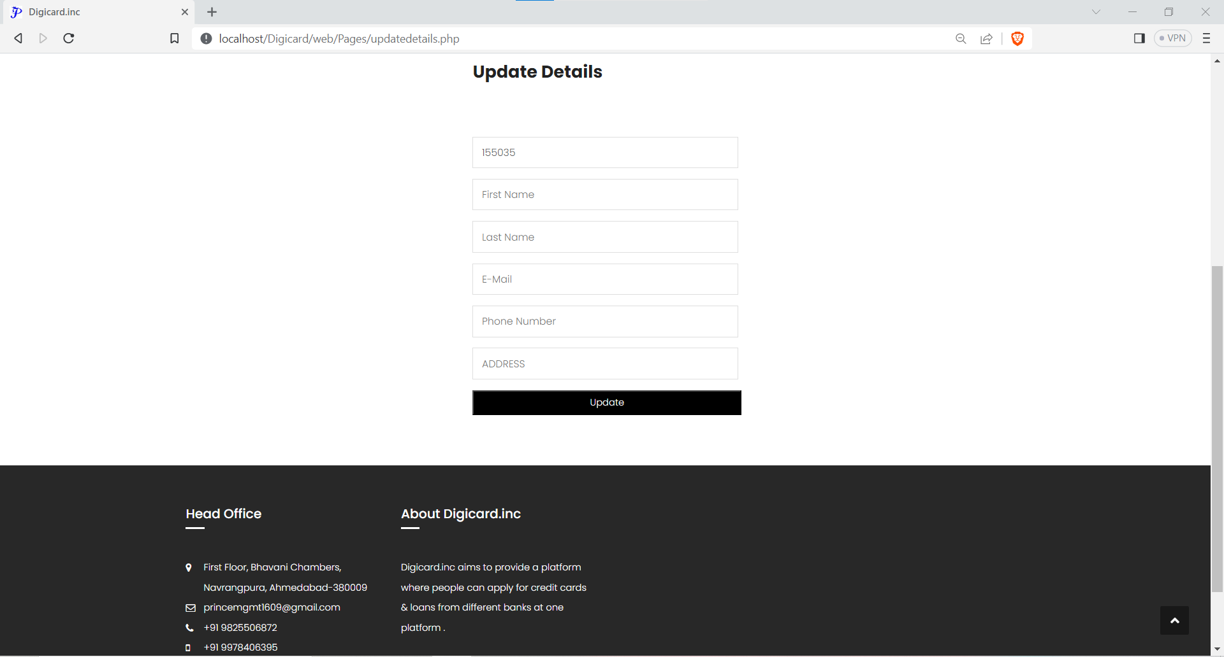

Slide 51
Products Page
Users can find all the products that are, Credit Cards provided by all the channel partner bank for applying product page.

Slide 52
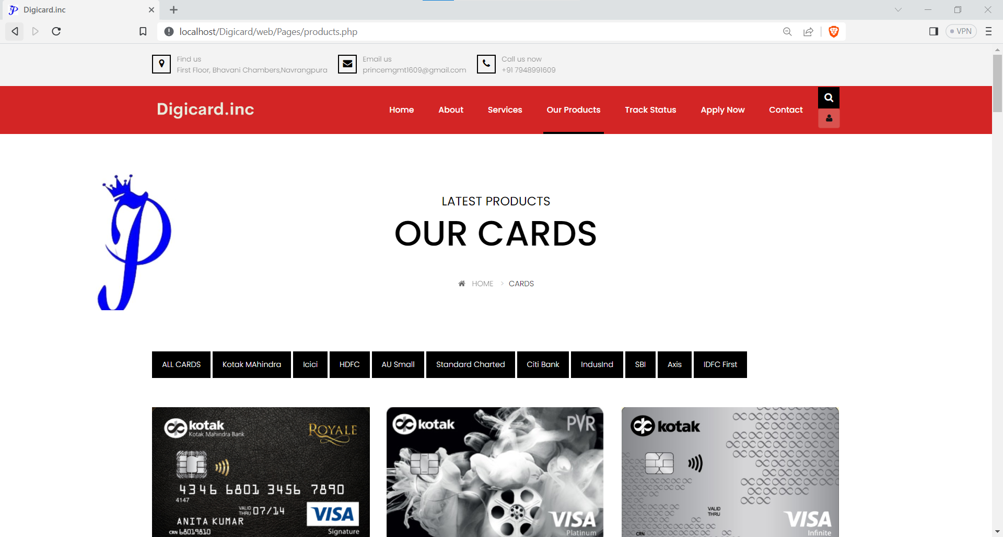

Slide 53
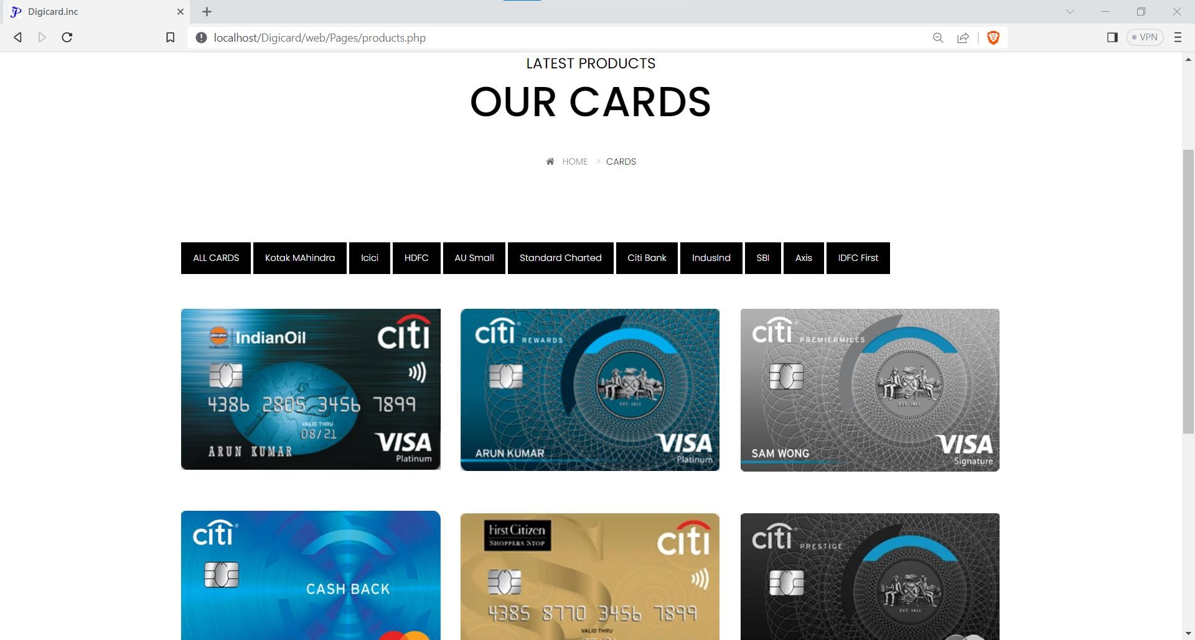

Slide 54
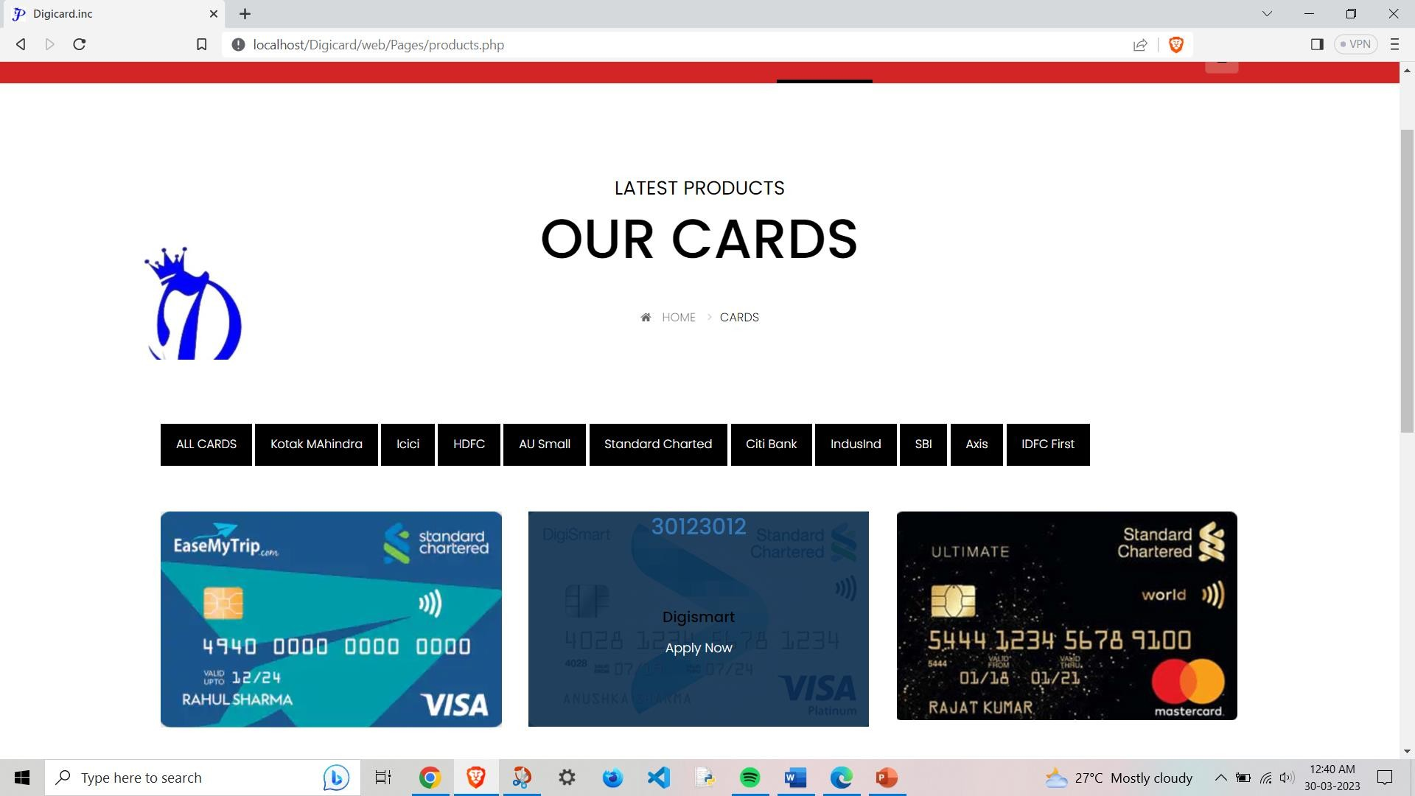
Hover the mouse cursor on the product and you will get the product name and apply now option

Slide 55
CHECK ELIGIBILITY
Users can chek theire eligibility for the credit card by bovering on the apply now and click on the chek eligibility page.

Slide 56
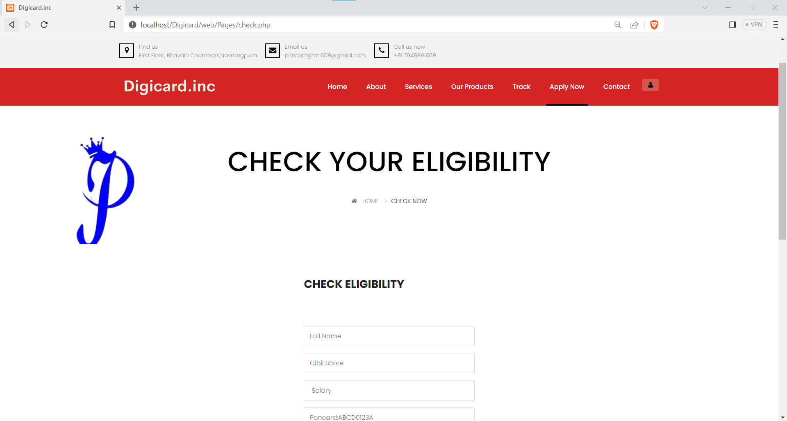

Slide 57
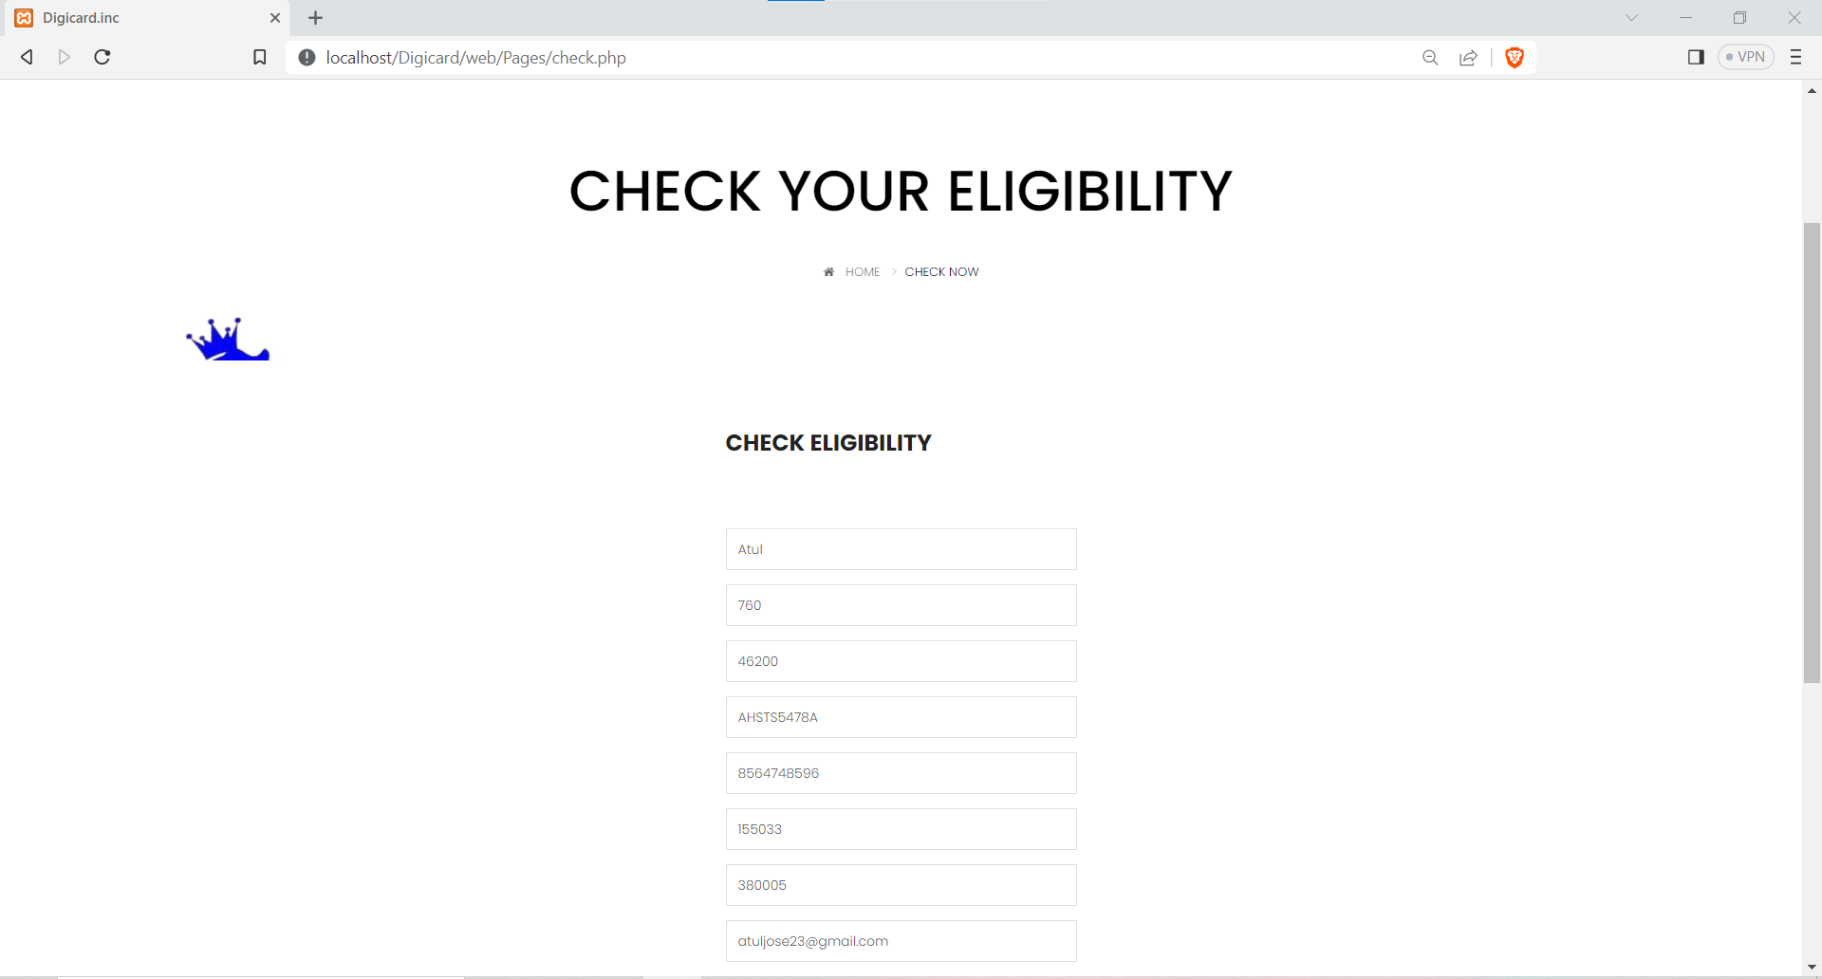

Slide 58
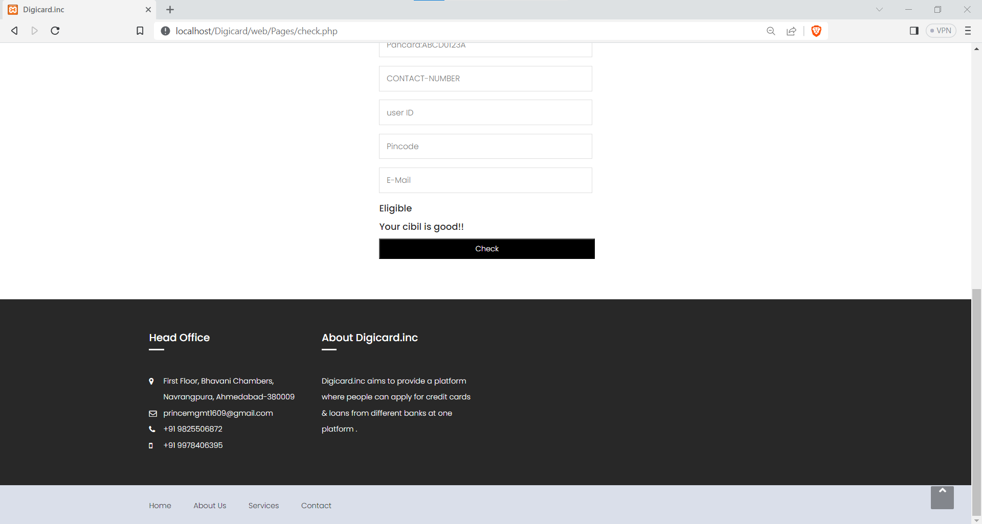

Slide 59
APPLY NOW
Users can apply for thr credit card by clicking on the apply Page or with the product page directly.

Slide 60
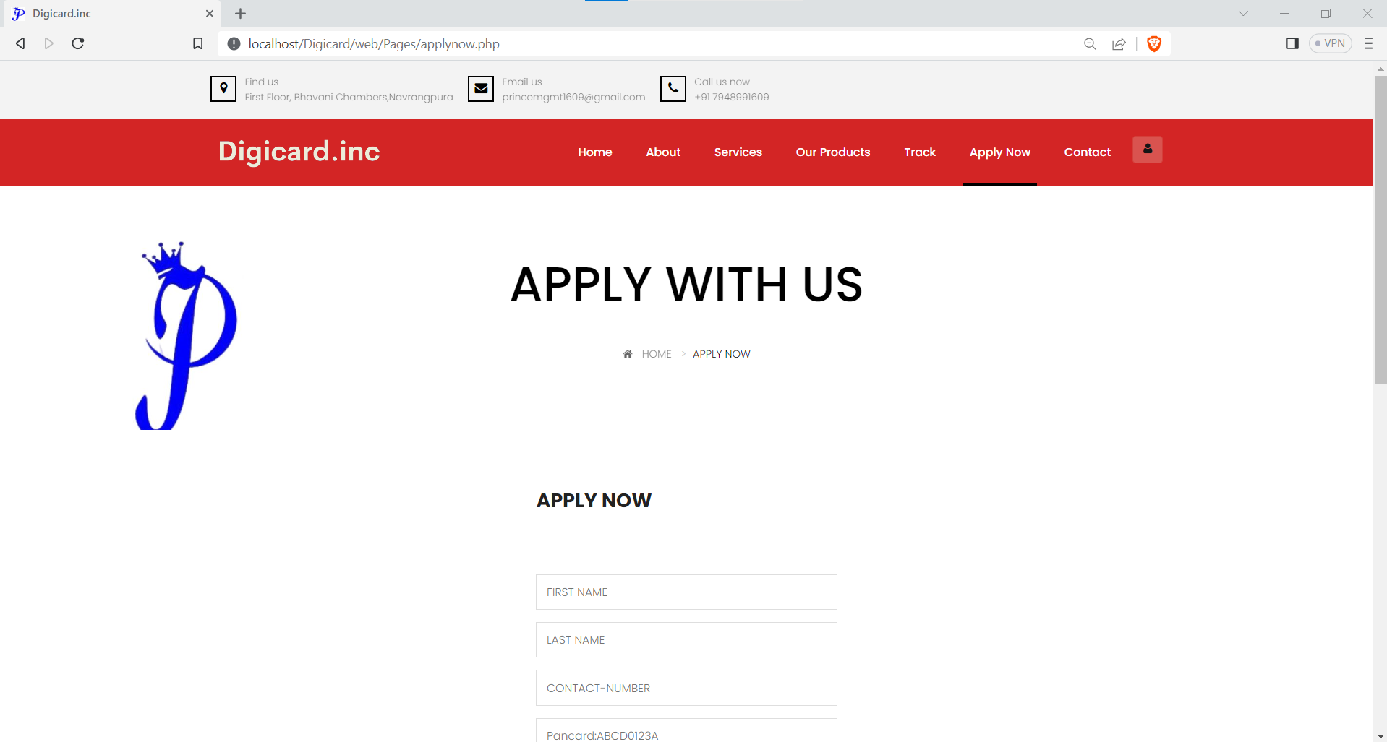

Slide 61
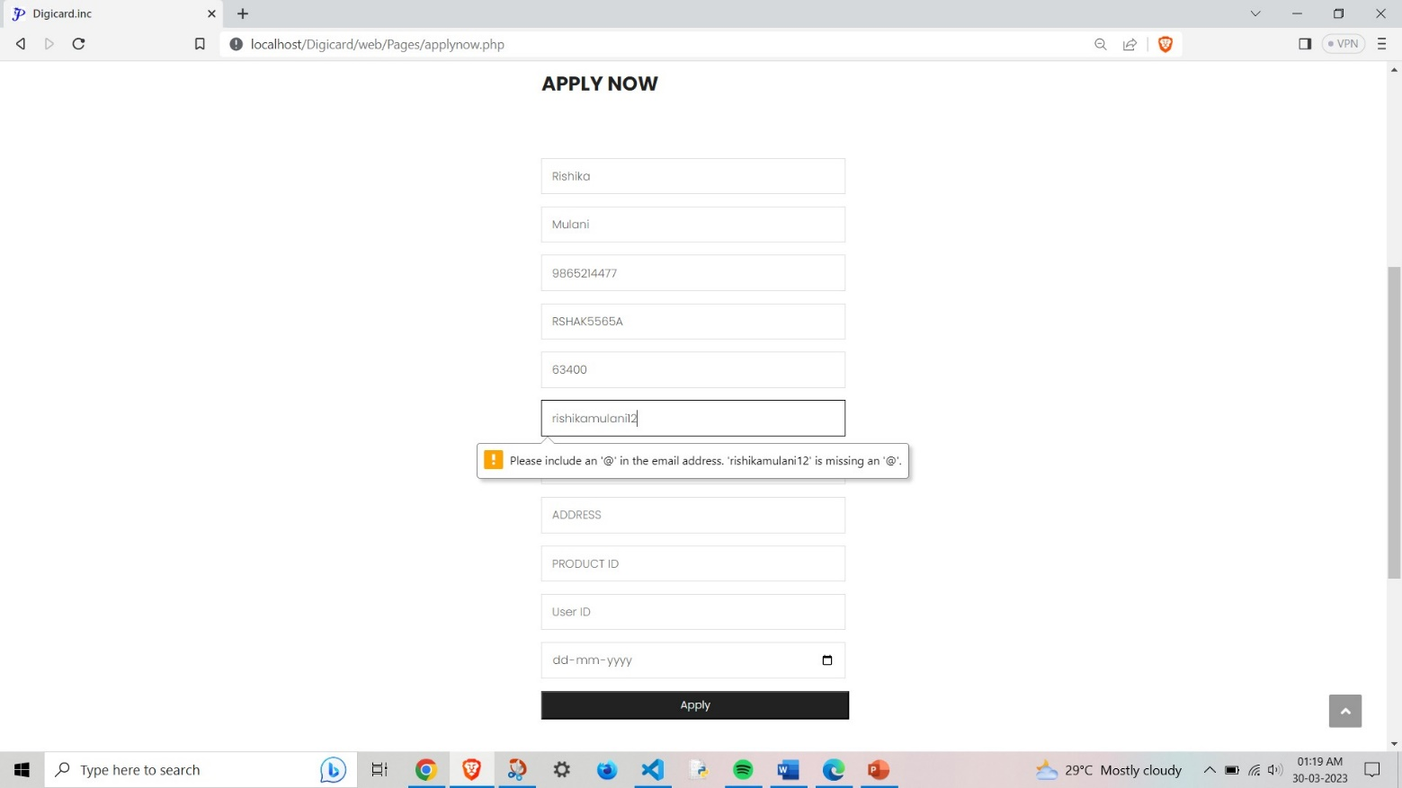

Slide 62
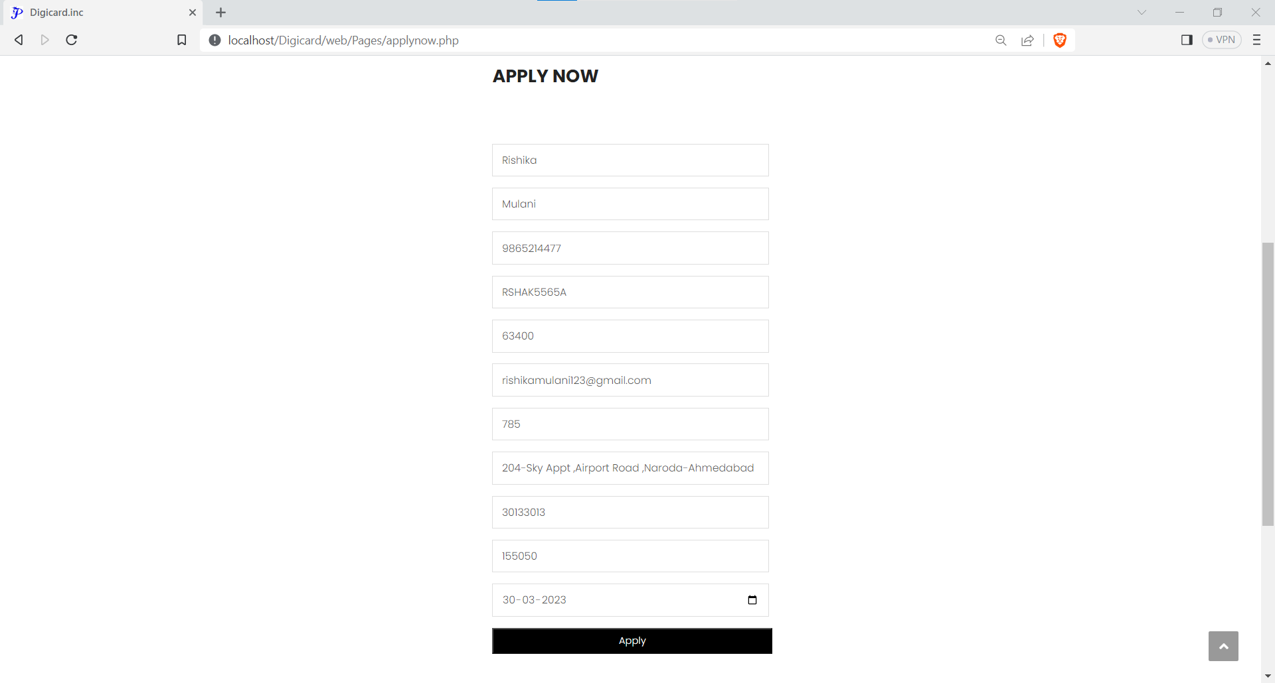

Slide 63
Track Status
Users can track the status of the application by clicking the Track Page.

Slide 64
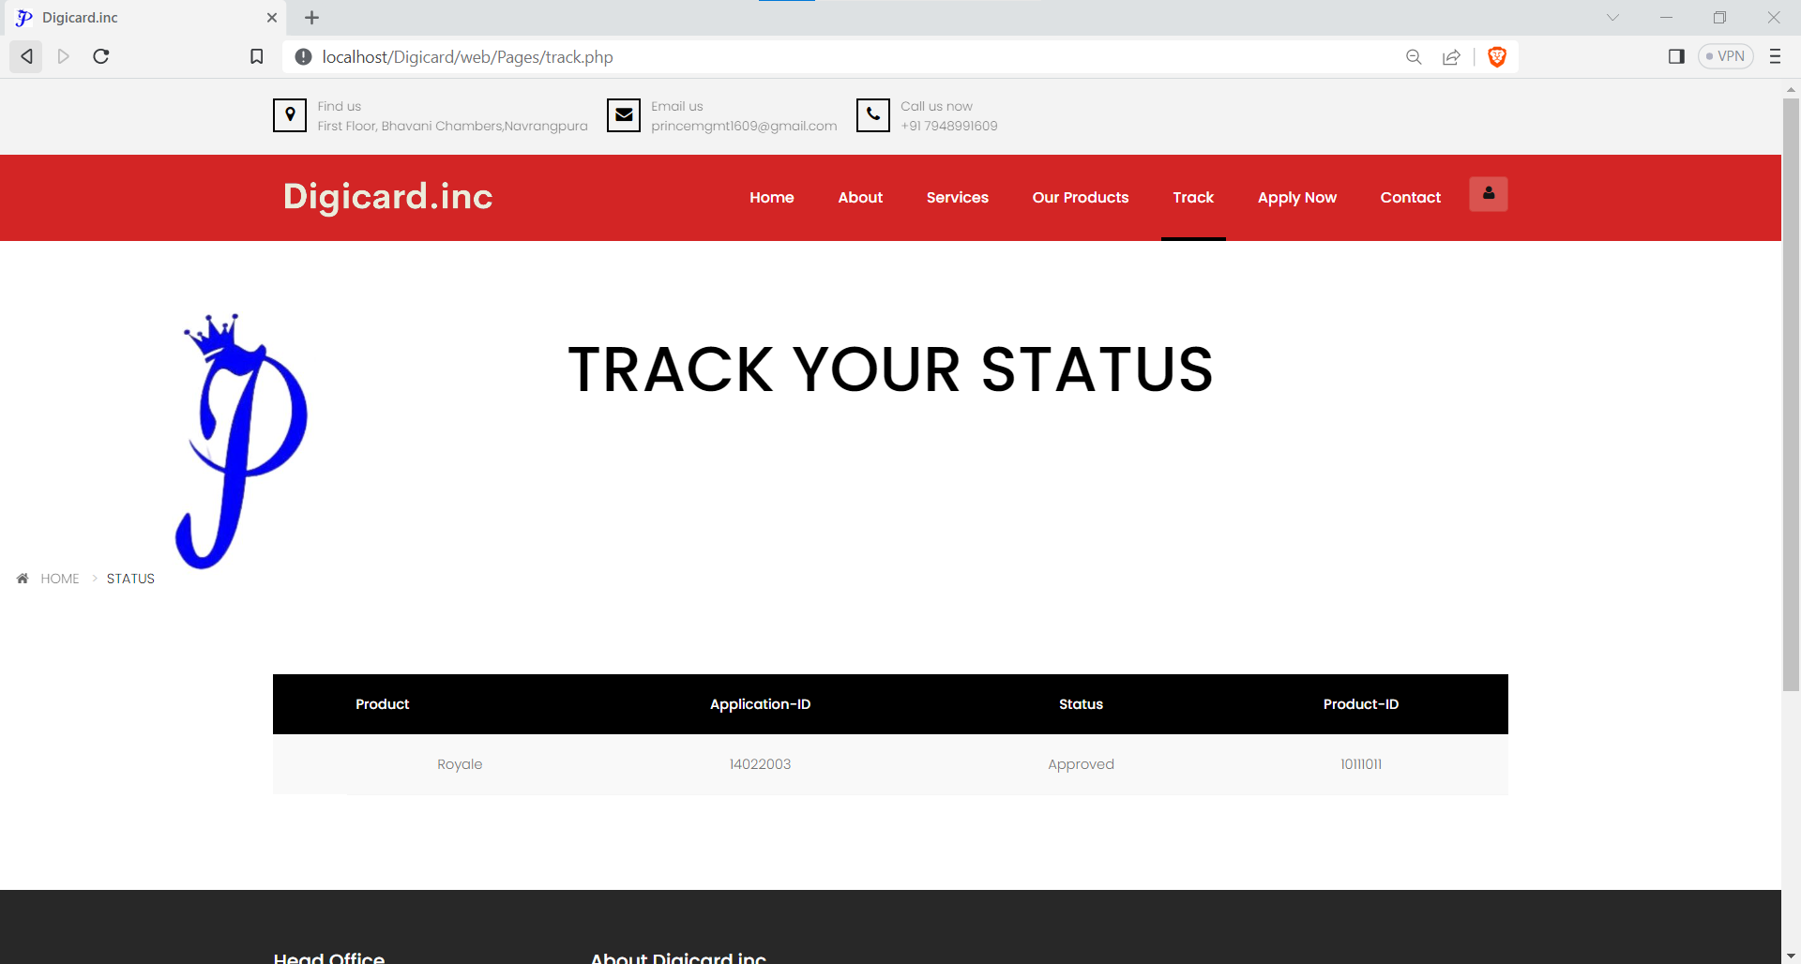

Slide 65
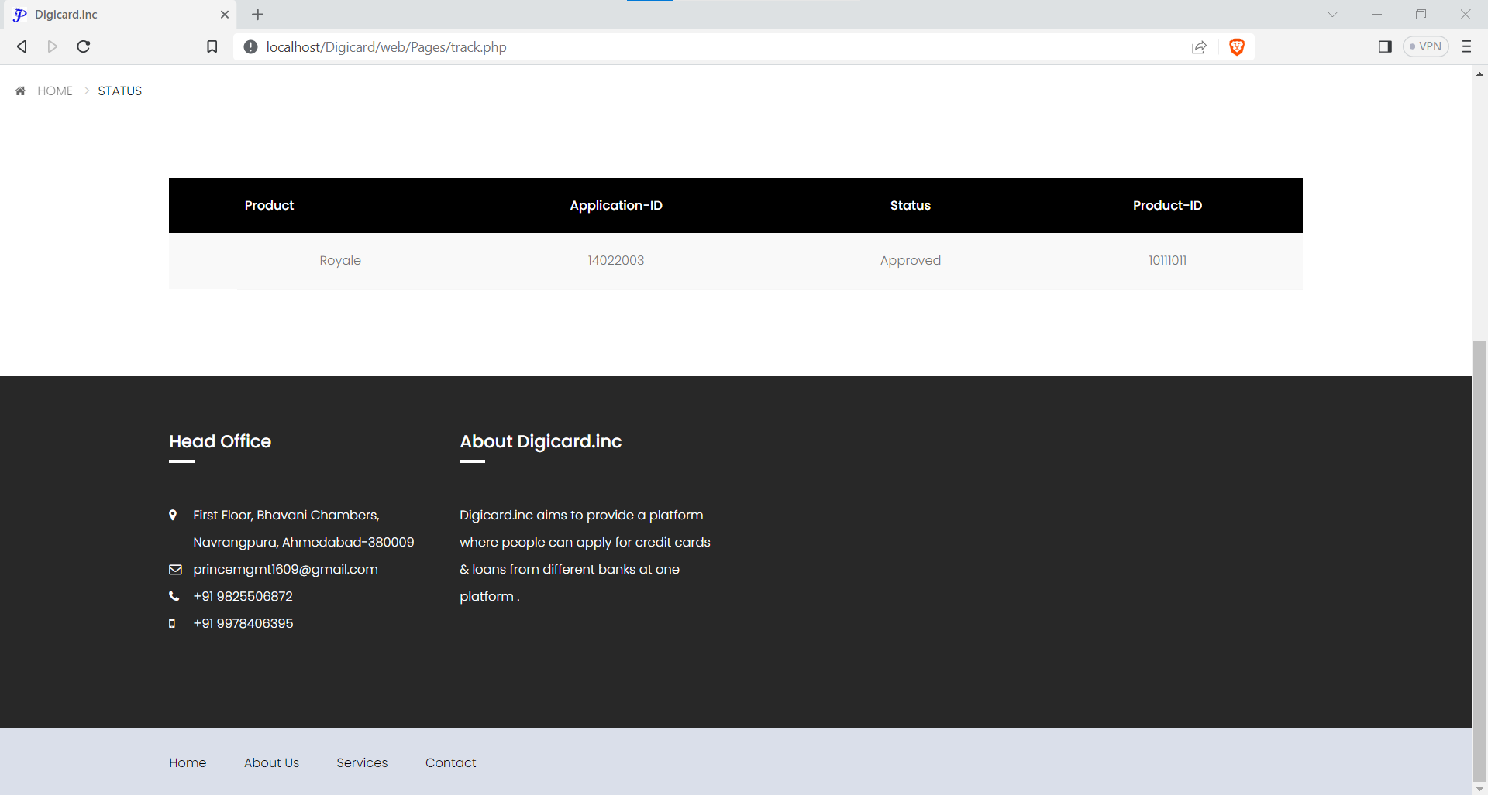

Slide 66
Sub-admin Dashboard
Sub-admin can view and manage all the products and on the website, and view reports ,receive applications from bank and forward the applications by using the sub-admin dashboard

Slide 67


Slide 68
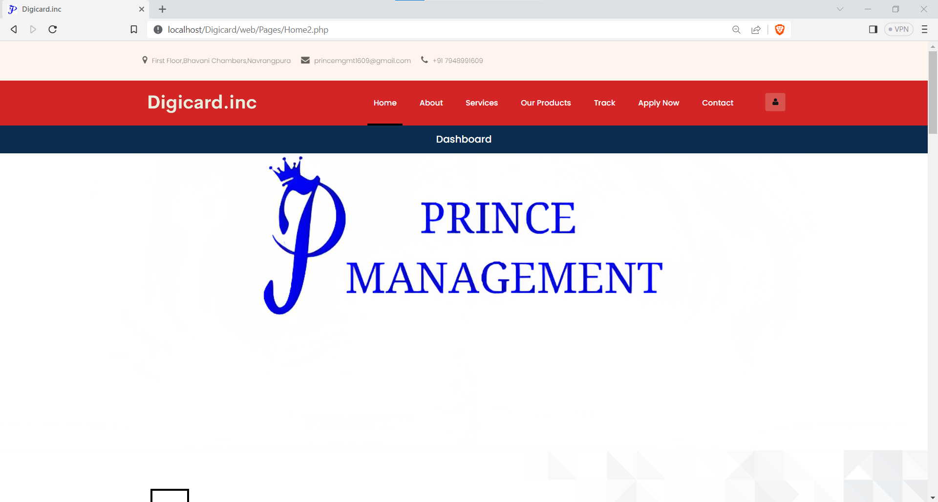

Slide 69
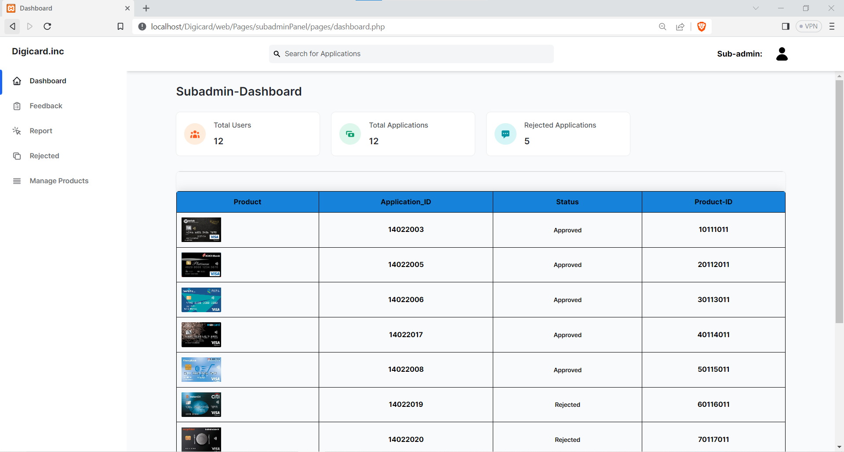

Slide 70
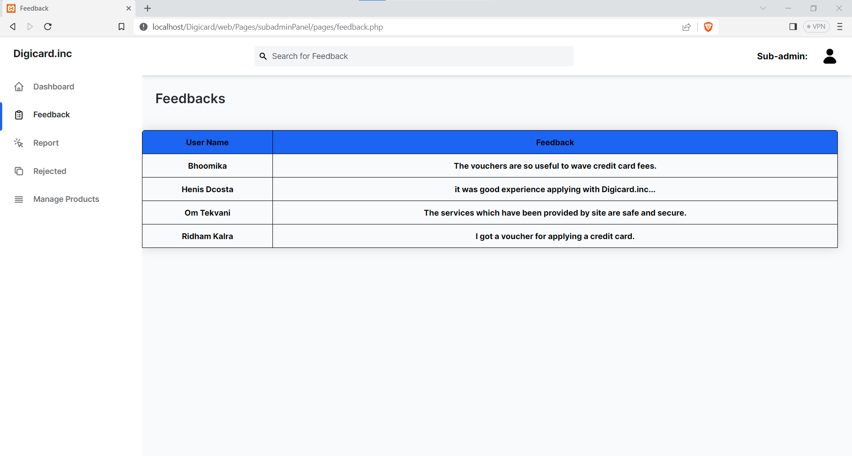

Slide 71
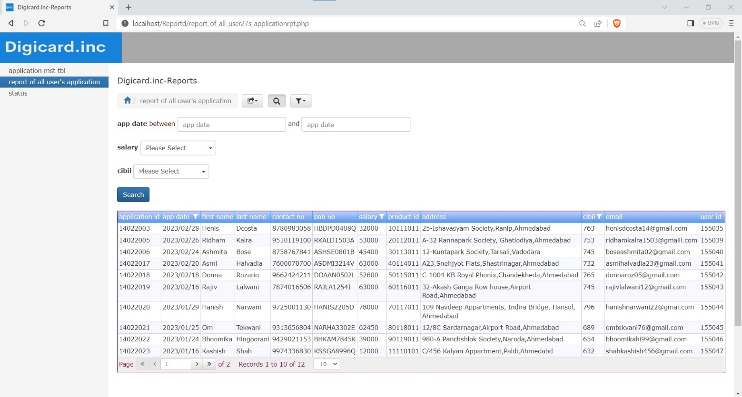

Slide 72
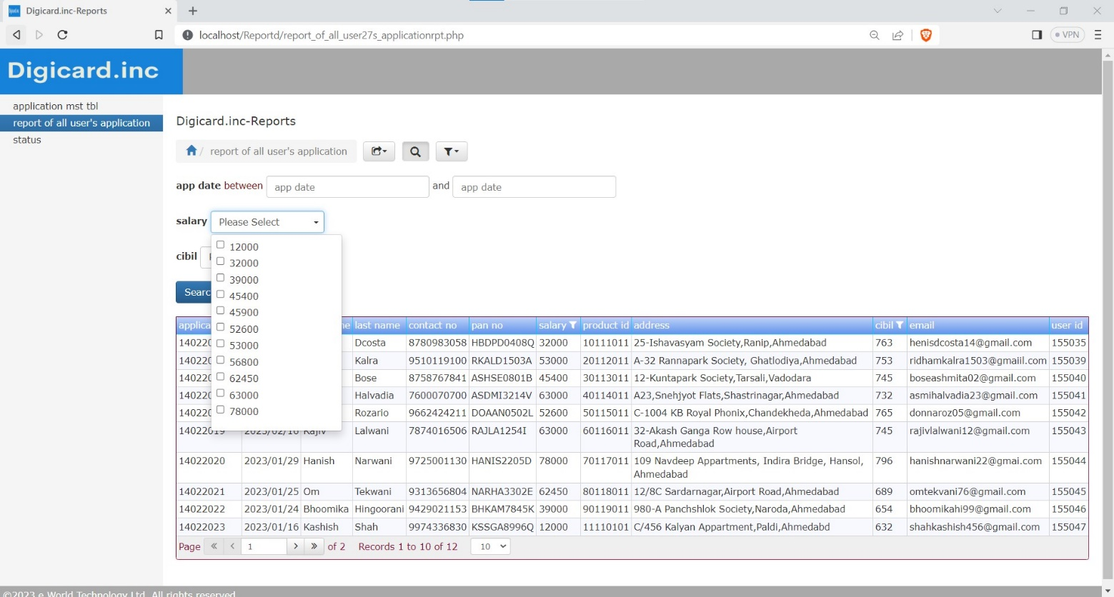

Slide 73
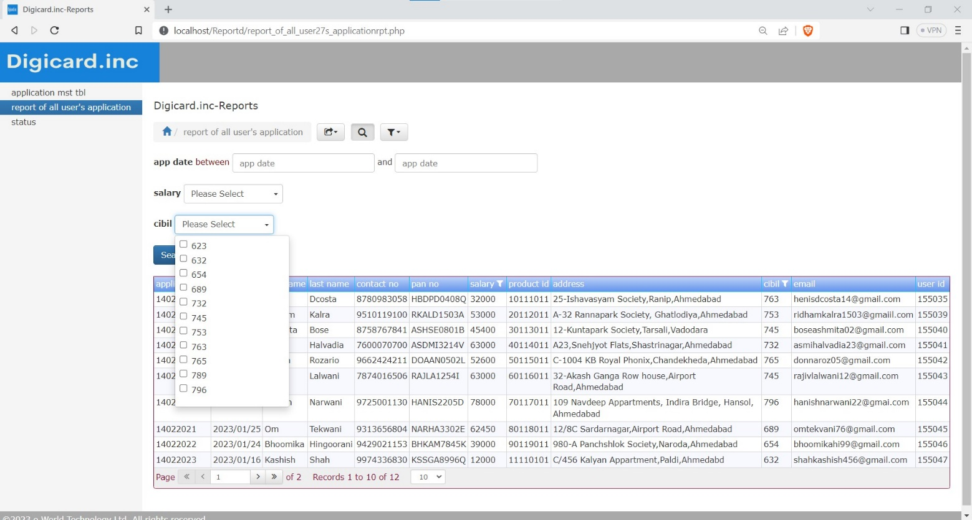

Slide 74
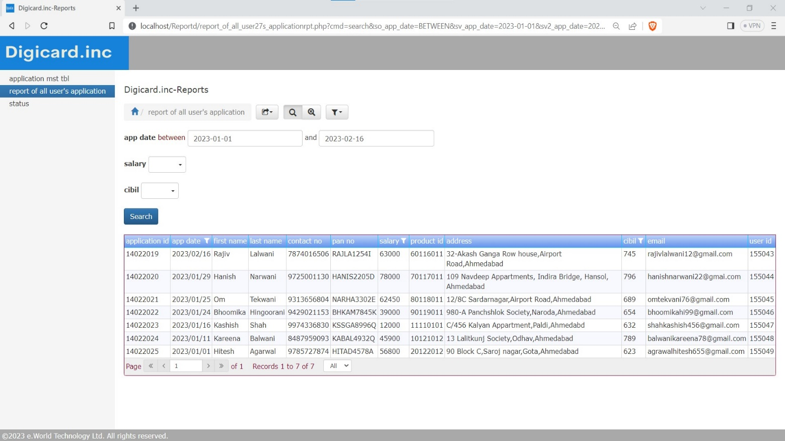

Slide 75
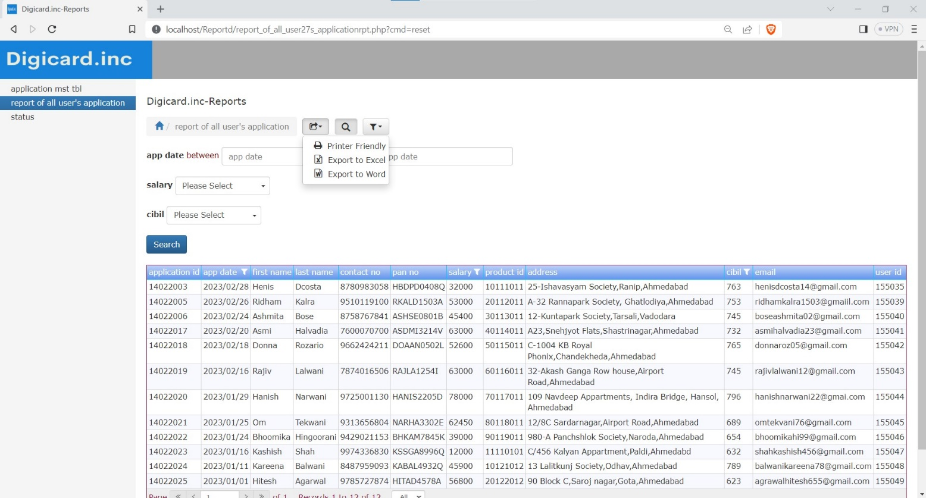

Slide 76


Slide 77


Slide 78


Slide 79

For Edit Product details.

Slide 80
For Delete Product

Slide 81


Slide 82


Slide 83
Admin Dashboard
Admin can view user applicationon the website, and view give voucher ,receive rejected applications from bank by using the Admin dashboard

Slide 84


Slide 85


Slide 86


Slide 87


Slide 88


Slide 89


Slide 95


Slide 96
Bank Dashboard
Bank Admin can verify user applicationon, and generate the report by using the bank dashboard,and upload the status of users application.

Slide 97


Slide 98


Slide 99


Slide 100


Slide 101


Slide 102


Slide 103


Slide 104


Slide 105


Slide 106


Slide 109
THANK YOU!!

